Slide 1

The European Integrate Network

Slide 2
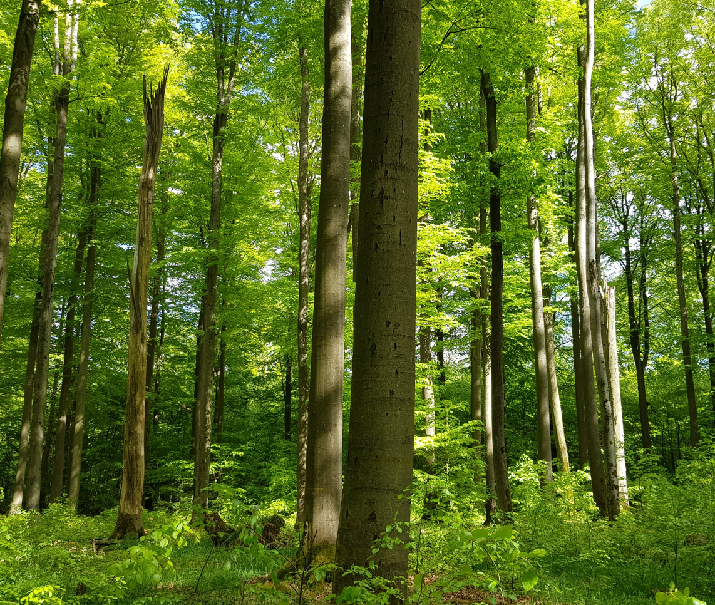
Our approach
promoting forest management approaches for the integration of nature conservation into sustainable forest management​
gathering scientific evidence on the successful application, training, and communication of such approaches
Notes:
“The European network Integrate promotes and advances forest management approaches for the integration of nature conservation into sustainable forest management at three levels: the decision-making policy level, the level of forest practitioners/managers, and the level of research and academic knowledge”
Voluntary network initiated by Prague Declaration on Forests and with mandate by the EU Standing Forestry Committee
Focus on further integration of nature conservation enhancement in sustainably managed forests in Europe.
Initiative driven by country representatives and their topical interests, currently 19 European countries participating, European Commission observer (DG AGRI and DG ENV)
Chairs: DE (2017), CZ (2018), PL (2018/2019), DK (2019/2020), CH (2020/2021), ES (2021/2022) Luxembourg (2023)

Slide 3
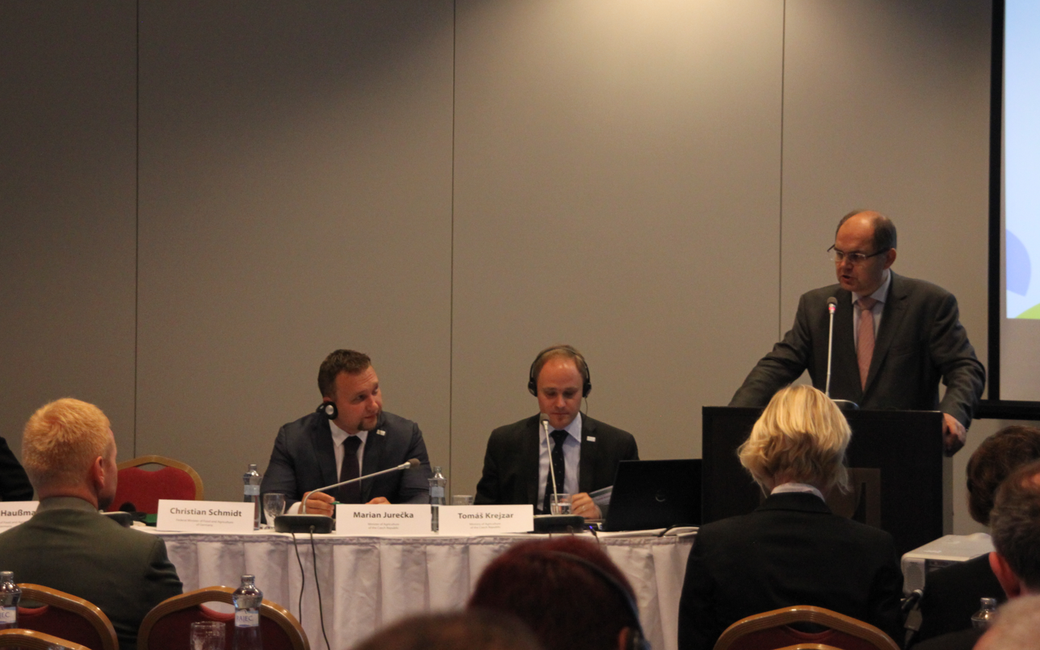
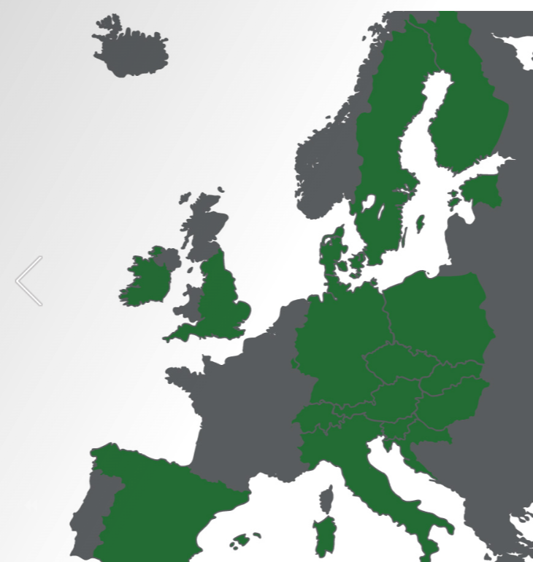
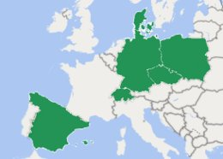
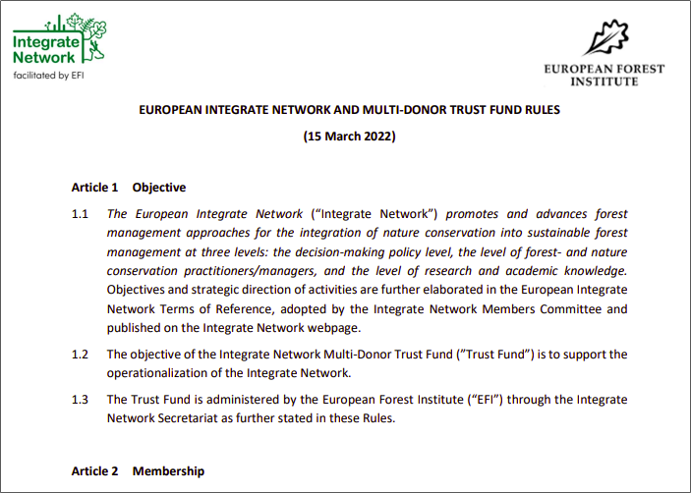
The process
*Portugal joined network in in 2021
2016
Integrate Network
2022
Integrate member and chair countries
2022
MDTF
www.integratenetwork.org
Notes:
Image left
The Integrate Network was initially brought into life in 2016 by the German Federal Minister for Food and Agriculture, Christian Schmidt, and his Czech colleague, Marian Jurečka (outcome was the Prague Declaration), and subsequently supported by the European Commission’s Standing Forestry Committee.
2 maps in the middle
Small map on left
State in 2022: 19 member countries take part in the network with representatives from forest and nature conservation policy, forestry and conservation practice as well as the research community, with the European Commission being an observer.
Small map on right:
highlighted in green are member countries that have chaired; current chair Spain
Image right
In May 2022, the Integrate Network became the Integrate Network Multi-Donor Trust Fund.
-

Slide 4
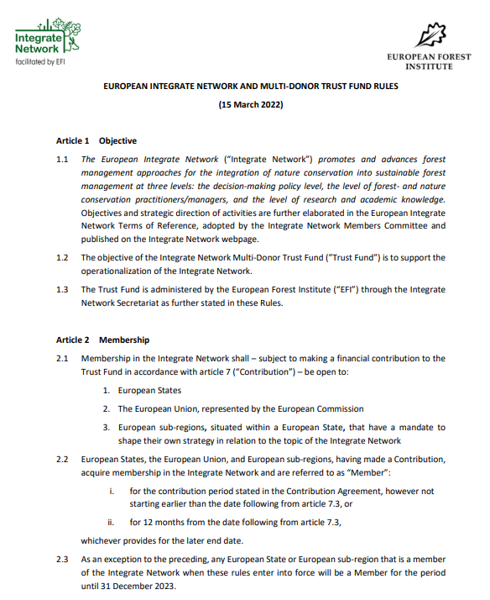
The Integrate Network Multi Donor Trust Fund
Move towards a more formal set-up of the Integrate Network
MDTF allows to support activities and impact of the Network independent of projects
MDTF strengthens joint ownership of the network
Guided by agreed MDTF rules
Members Committee acts as decision making body
EFI facilitates the Integrate Network as Secretariat
Notes:
Status Quo: With establishment of the MDTF, this format allows to continue promoting for the integration of nature conservation into sustainable forest management
-Despite the project ending the secretariat can be approached for questions and functions as focal point also to connect between parties in the network
-EFI facilitates the network as Secretariat
--> Through MDTF, funds for basic running of network via secretariat and targeted project actions is secured

Slide 5
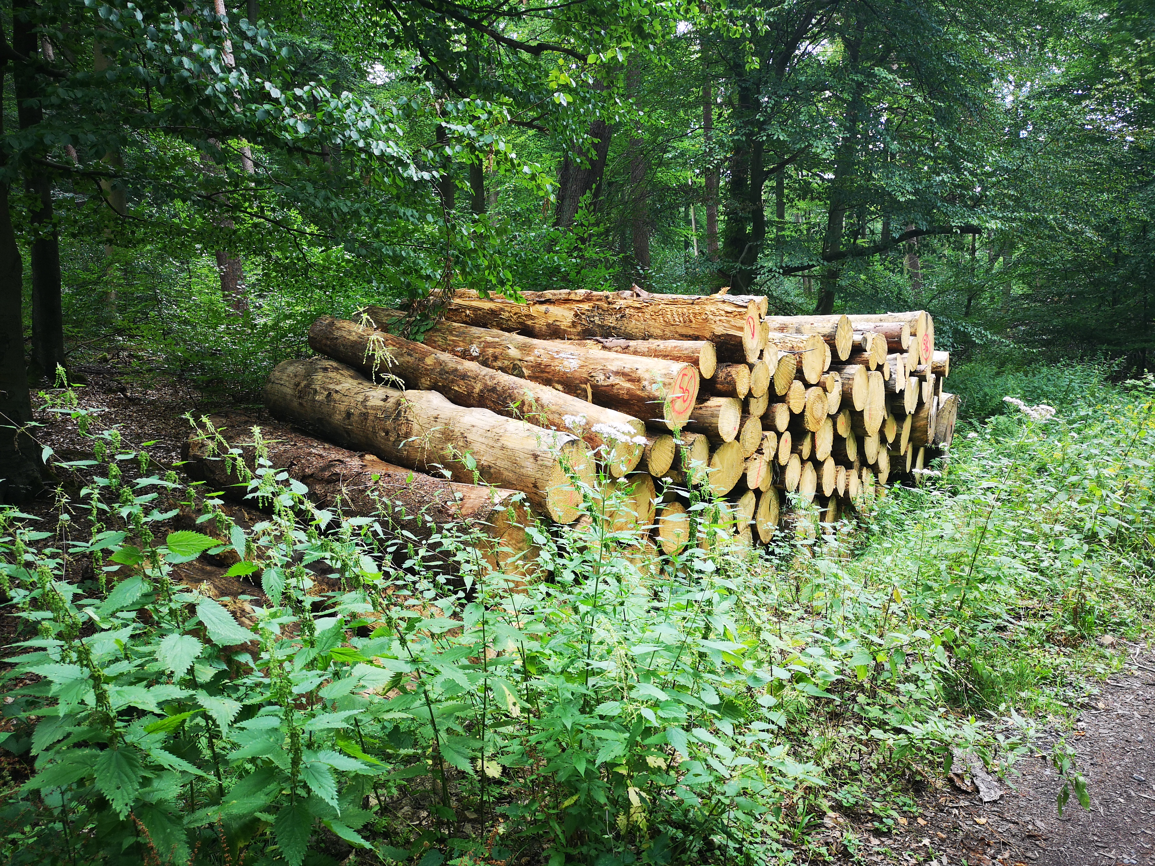
Integrate Network – selected activities
Events
Publications
Science-Policy Interface
Notes:
Listed on website (insert link)

Slide 6
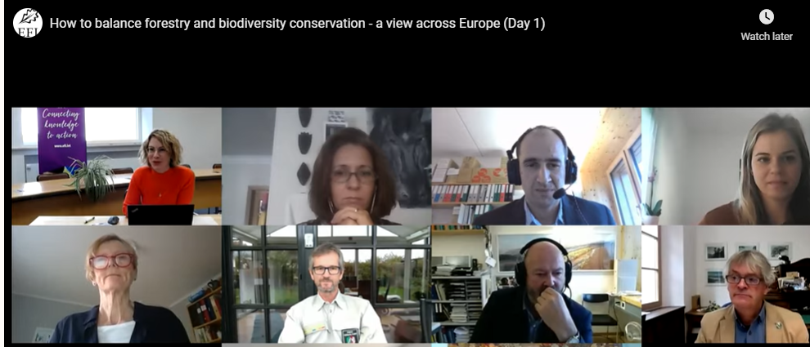
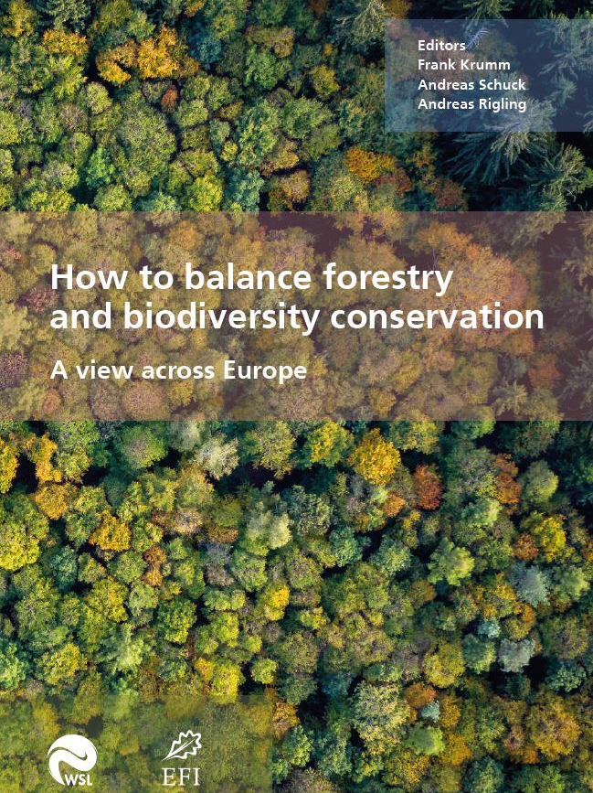
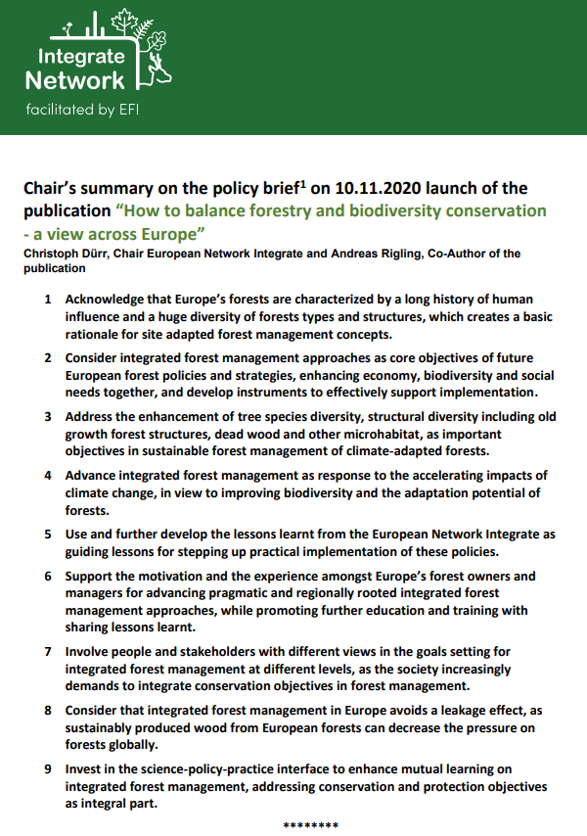
“How to balance forestry and biodiversity?” (9-10 November 2020)
Online conference with around 600 viewers during 2 days
Presentation of the book publication: “How to balance forestry and biodiversity conservation - a view across Europe” including 32 good practice examples on integrative forest management
Chair’s summary
Notes:
Listed on website (insert link)

Slide 7
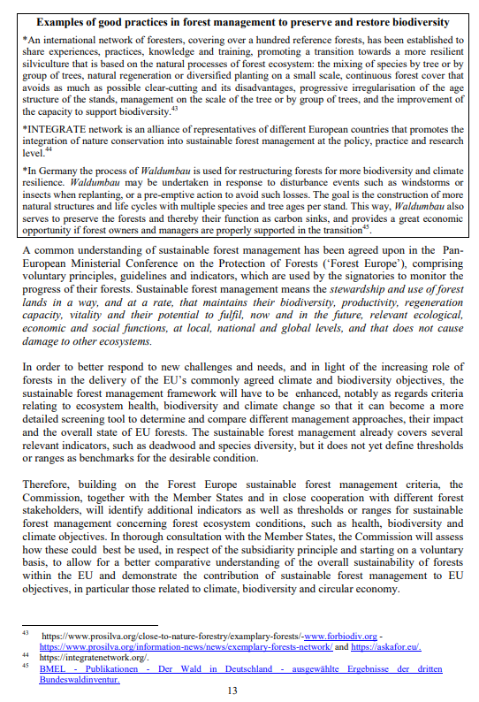
Engagement in European Commission consultation on the new EU Forest Strategy for 2030
Integrate Network submits a negotiated text as official contribution to the European Commission on the new EU Forest Strategy for 2030
EU Forest Strategy for 2030 - chapter 3: “Protecting, restoring and enlarging EU’s forests to combat climate change, reverse biodiversity loss and ensure resilient and multifunctional forest ecosystems”
Integrate Network mentioned as good practice example
Notes:
Listed on website (insert link)

Slide 8
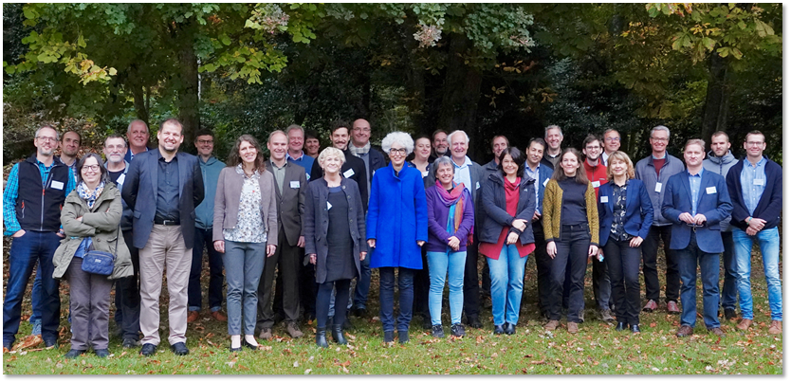
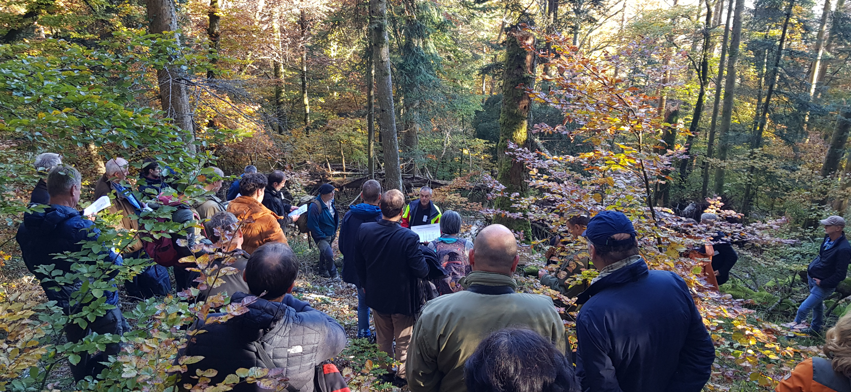
7th Integrate Network Annual Meeting in Neuchâtel / Boudry, Switzerland (27-29 Oct 2021)
Current policy developments in the EU
Forests in 2080: Biodiversity and adaptation to climate change in future forest management
Balancing forestry and biodiversity conservation – perspectives from science and practice
Discussions on the publication: “How to balance forestry and biodiversity conservation - a view across Europe”
Excursion to Boudry forest
Notes:
Selected events from the past years...

Slide 9
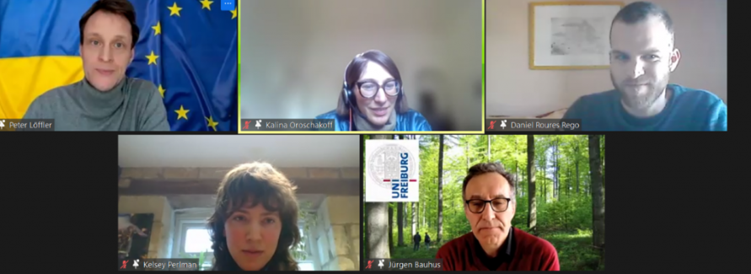
Facilitating webinars on current European topics
Policy challenges of integrating biodiversity conservation in forest management – the way forward (03/2021)
EU Forest Strategy: Strengthening forests for biodiversity & climate change (09/2021)
Webinar EU Forest Strategy, September 2021
Notes:
Selected events from the past years...

Slide 10
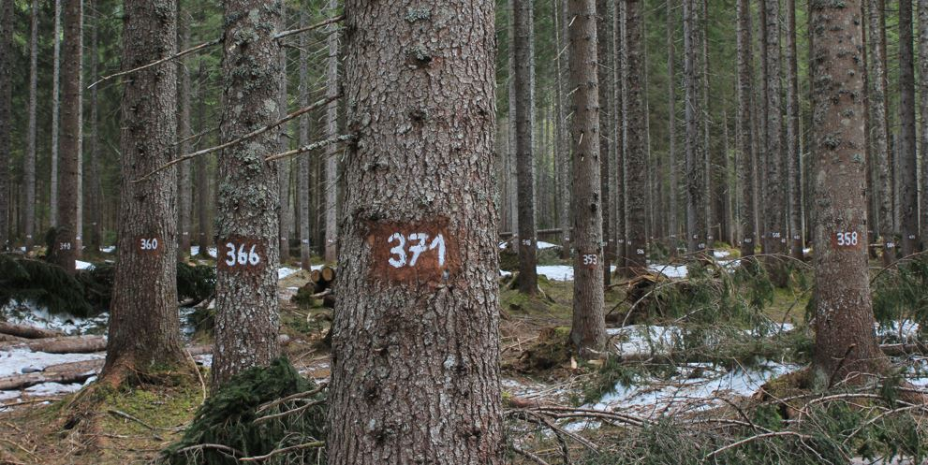
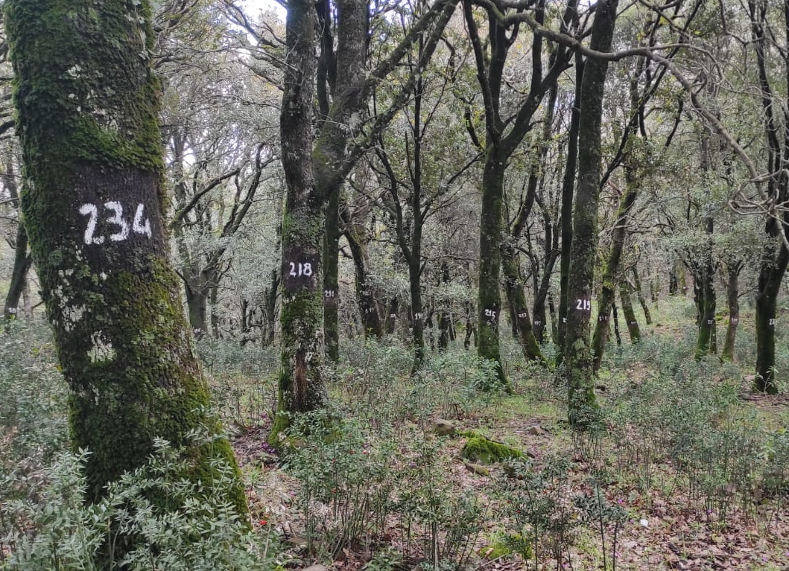
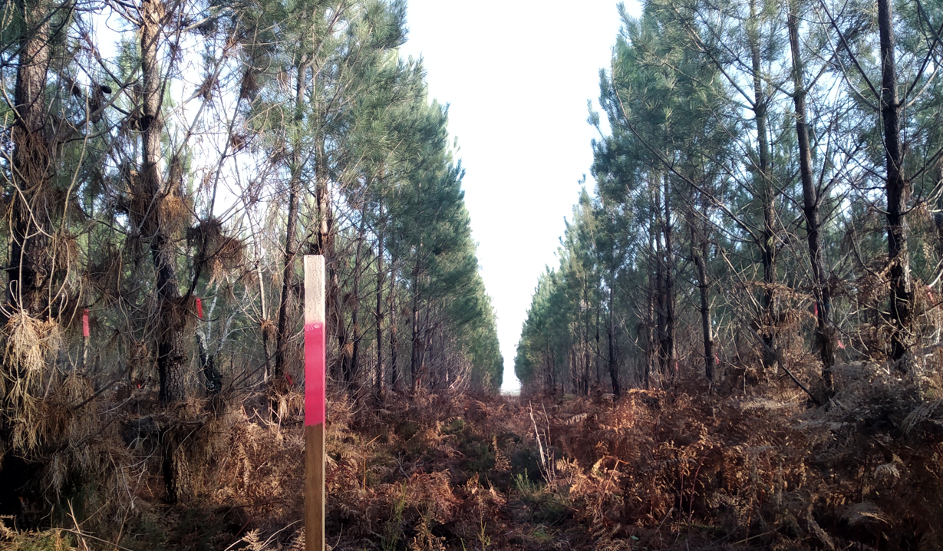
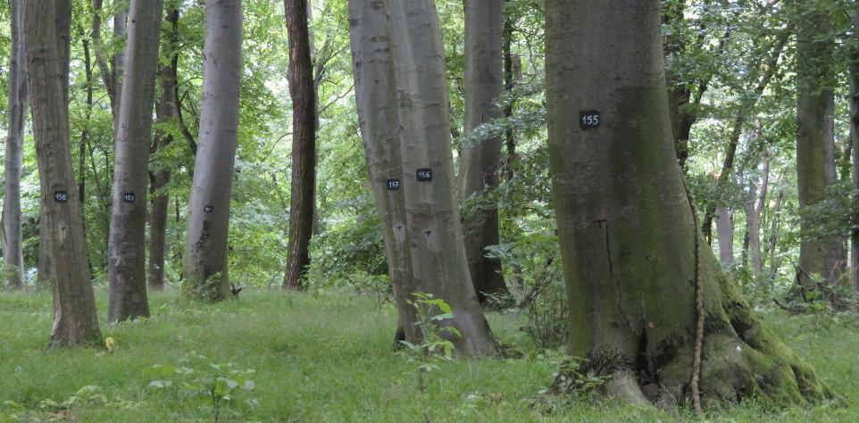
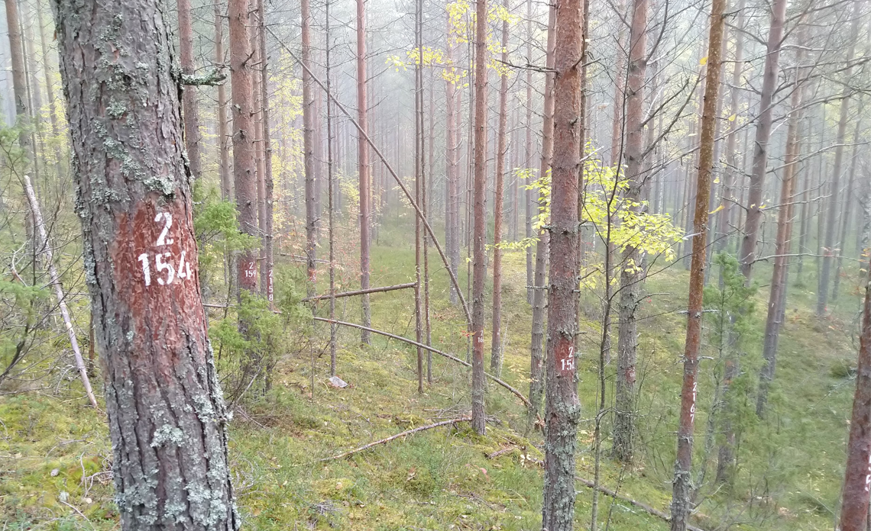
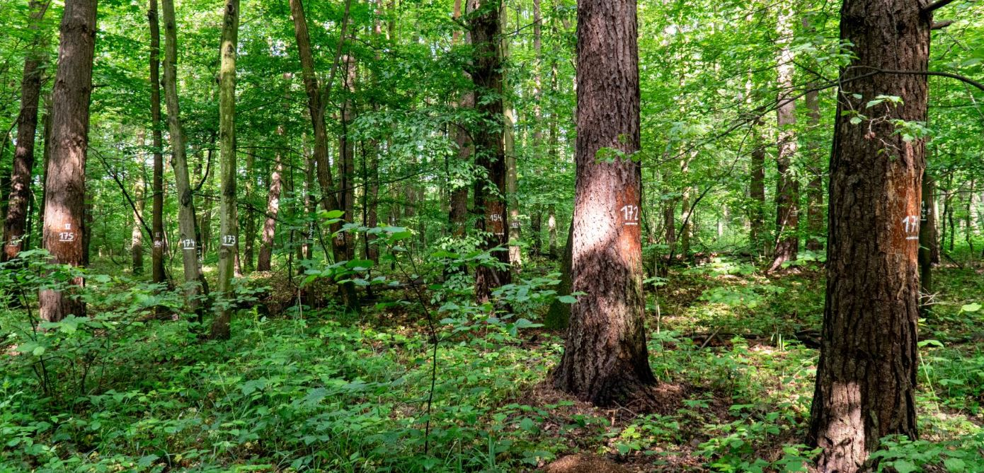
Integrate demonstration site network
About 180 sites in 22 European countries, site network continues to expand
Wide variety of forest types and management regimes
Training and education events take place, training programmes are developed
Photos: local marteloscope managers

Slide 11
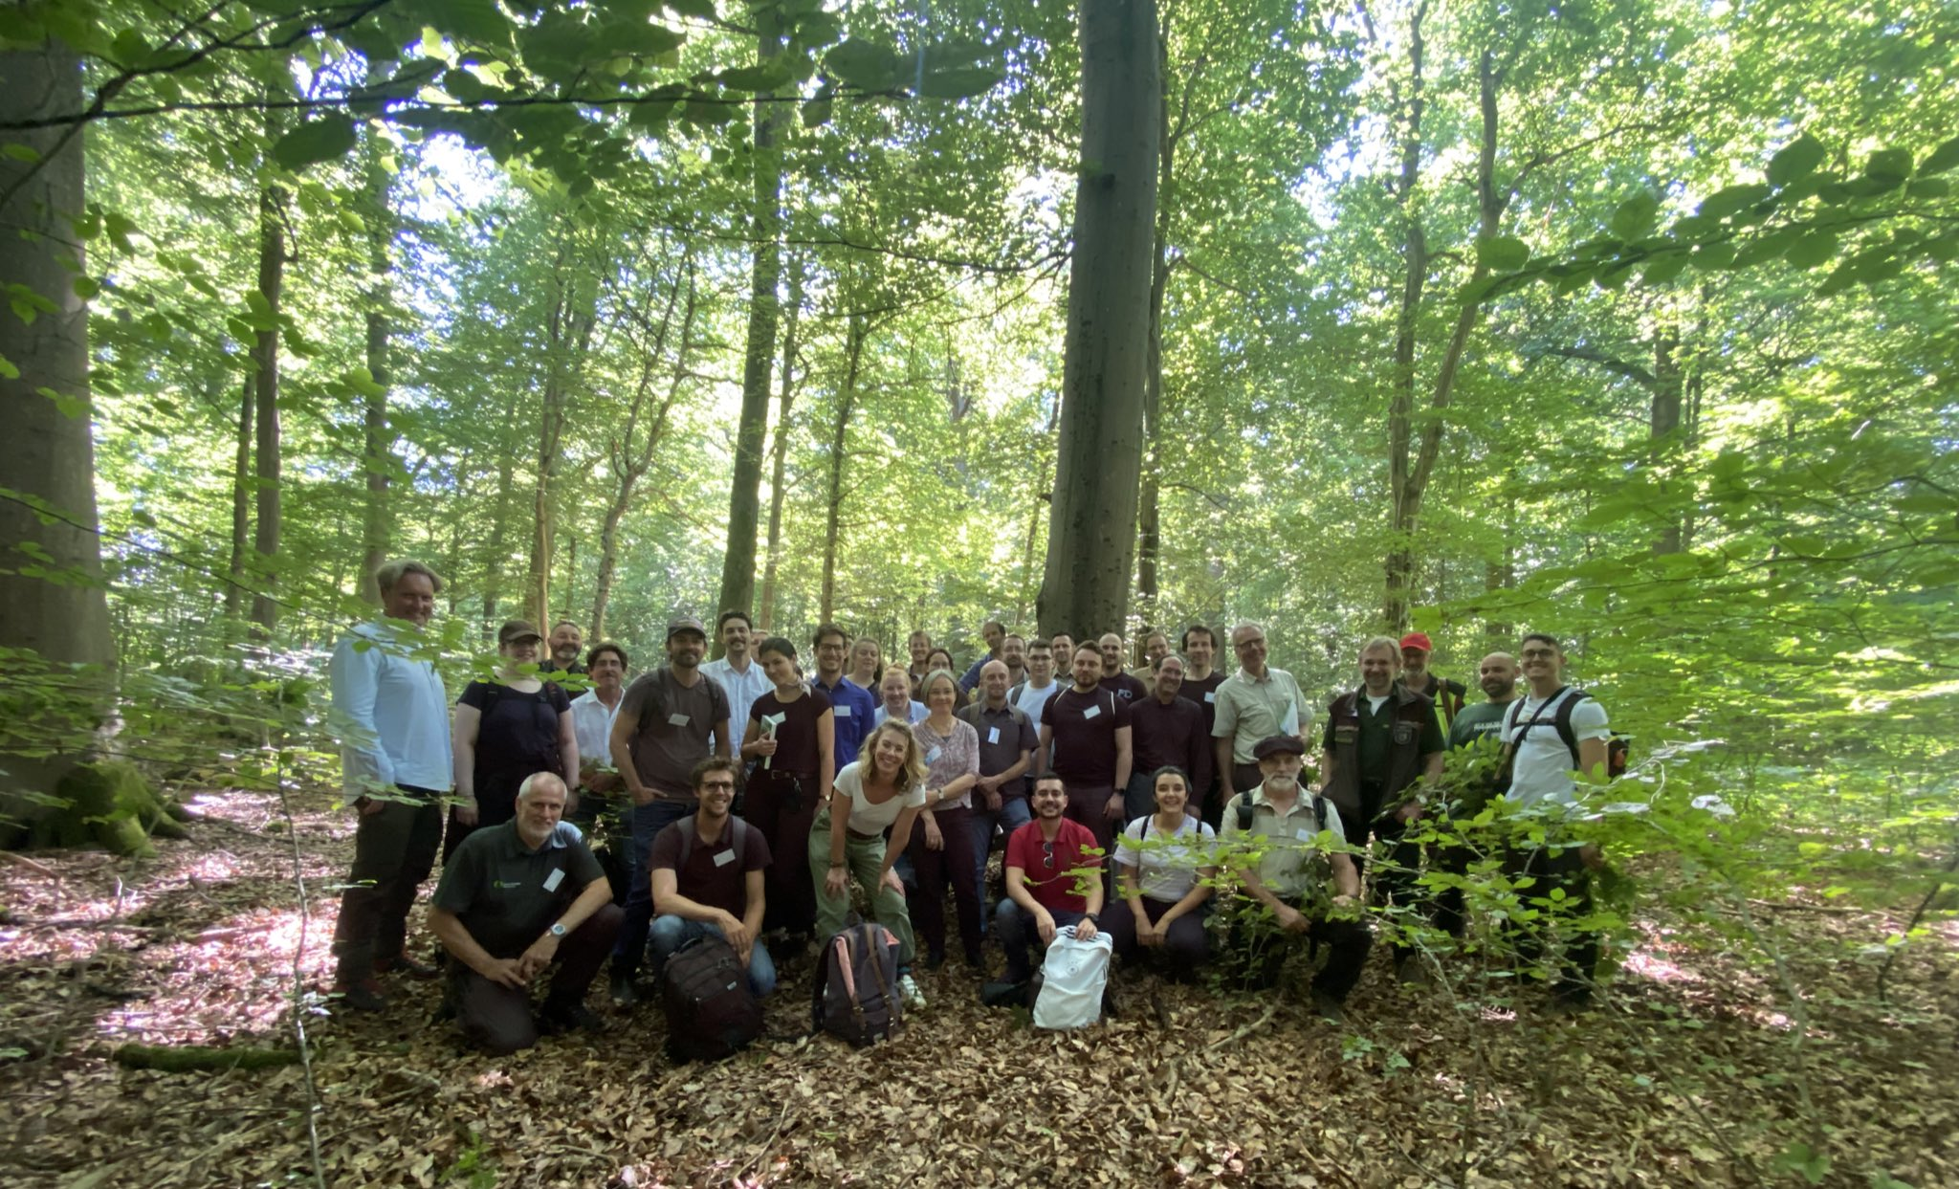
Manager Workshop (28-29 Jun 2022)
Over 50 marteloscope managers, researchers, and other forestry experts from more than 12 European countries gathered in Bonn
Sharing experiences on technical, practical and training/educational issues with marteloscopes as well as their application in research
Exchange of ideas on further development and use of demonstration sites
Notes:
Selected events from the past years...

Slide 12
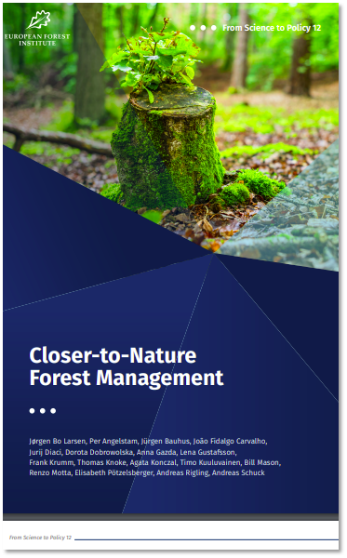
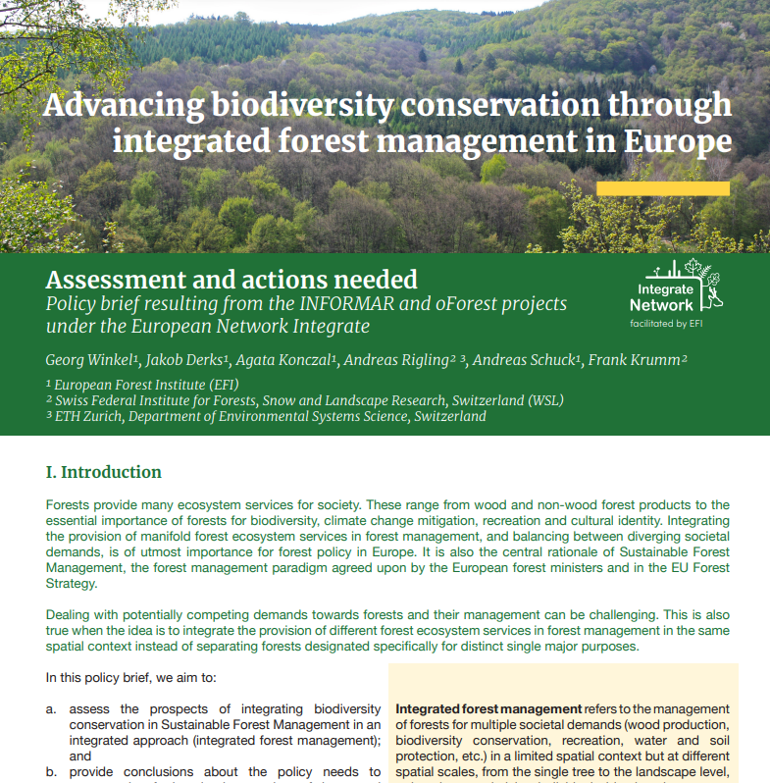
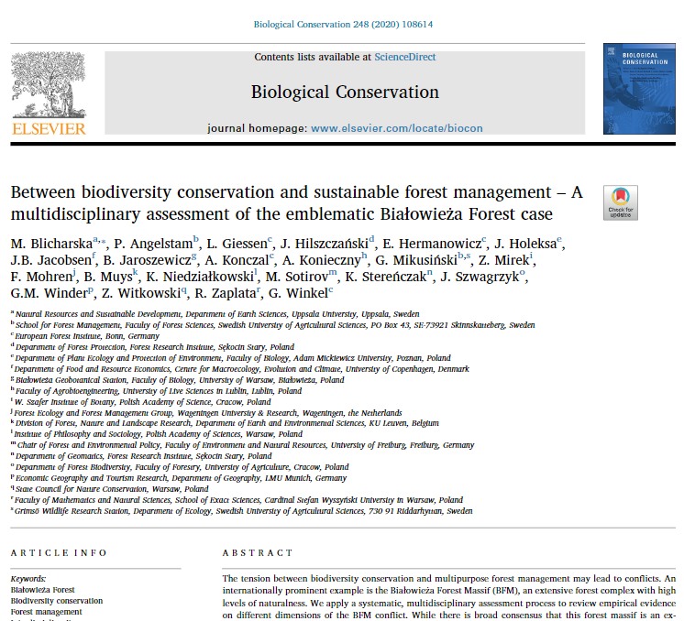
Policy briefs and scientific publications
Policy Briefs
‘Advancing biodiversity conservation through integrated forest management in Europe’(2020)
Support to ‘Closer-to-nature forest management’ - From Science to Policy (2022)
Scientific papers
Blicharska, M. et al., 2020. Between biodiversity conservation and sustainable forest management A multidisciplinary assessment of the emblematic Białowieża Forest case. Biological Conservation.
Larrieu, L., Cabanettes, A., Courbaud, B., Goulard, M., Heintz, W., Kozák, D., Kraus, D., Lachat, T., Ladet, S., Müller, J., Paillet, Y., Schuck, A., Stillhard, J., Svoboda, M., 2021. Co-occurrence patterns of tree-related microhabitats: A method to simplify routine monitoring. Ecological Indicators.
Notes:
Listed on website (insert link)

Slide 13
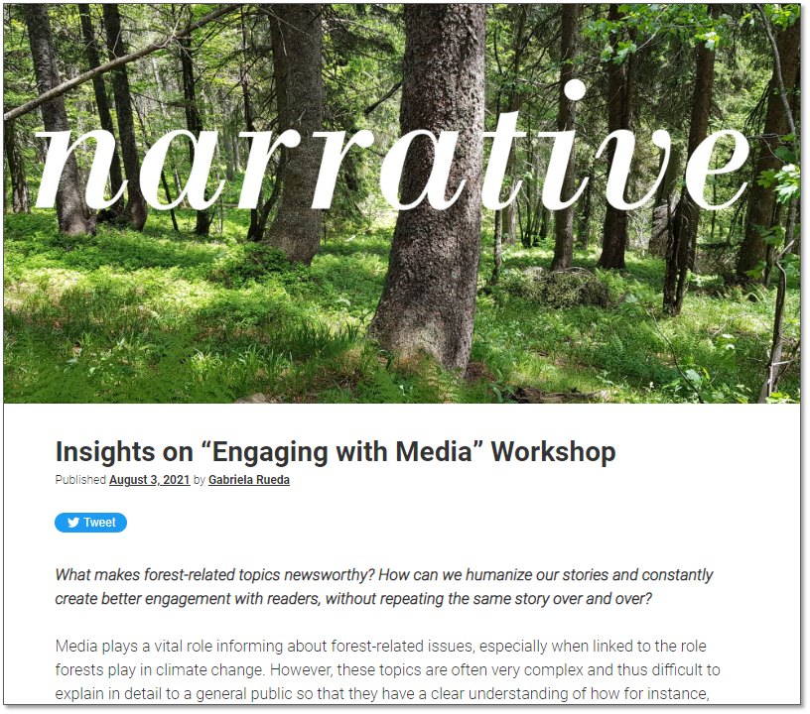

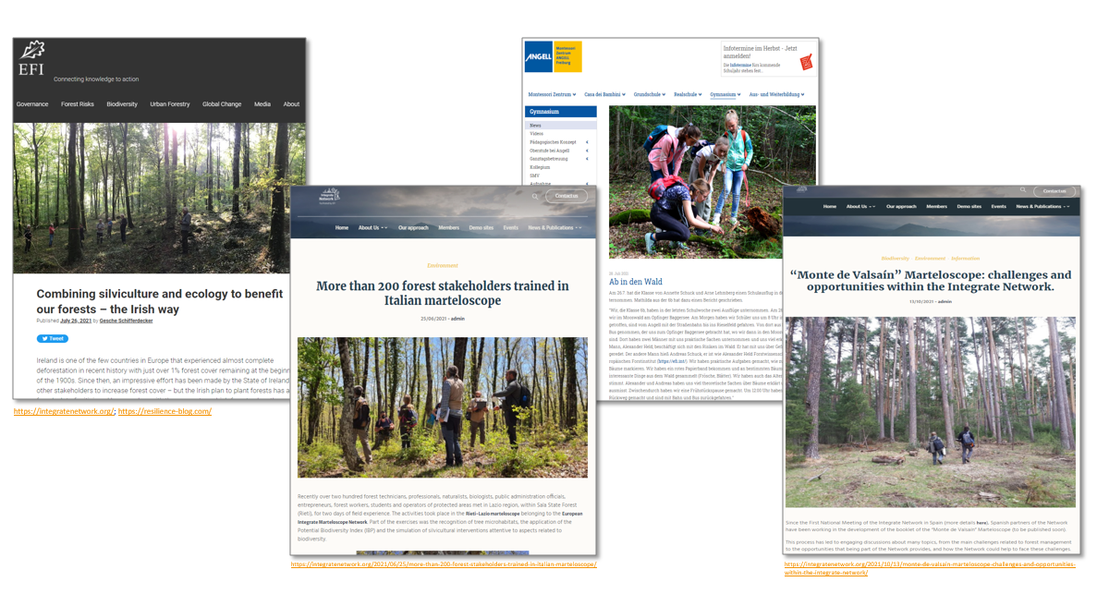
Communications
Website
Blog posts
Webinar support
Interviews with network members
Integrate newsletter
Audiovisuals
Communication training for network members
Workshop: „Storytelling“
Workshop „Engaging with media“
Notes:
Set of informational and communication materials (newsletter, videos, interviews, blogposts, flyer, and also scientific publications)

Slide 14
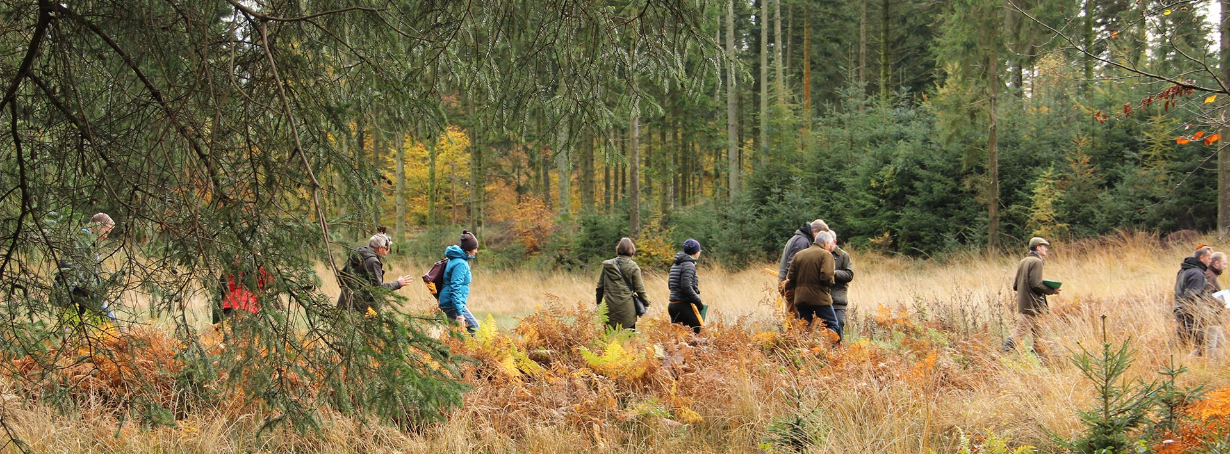
Thanks!
Integratenetwork.org
lrojo@miteco.es

