Slide 1
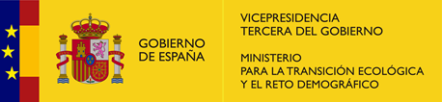


FONFARAÓN MARTELOSCOPE
A seed for a new management of the
Native Broadleaved Woodlands of Asturias
Juan Garrote Haigermoser
Regional Forest Service of Asturias

Slide 2
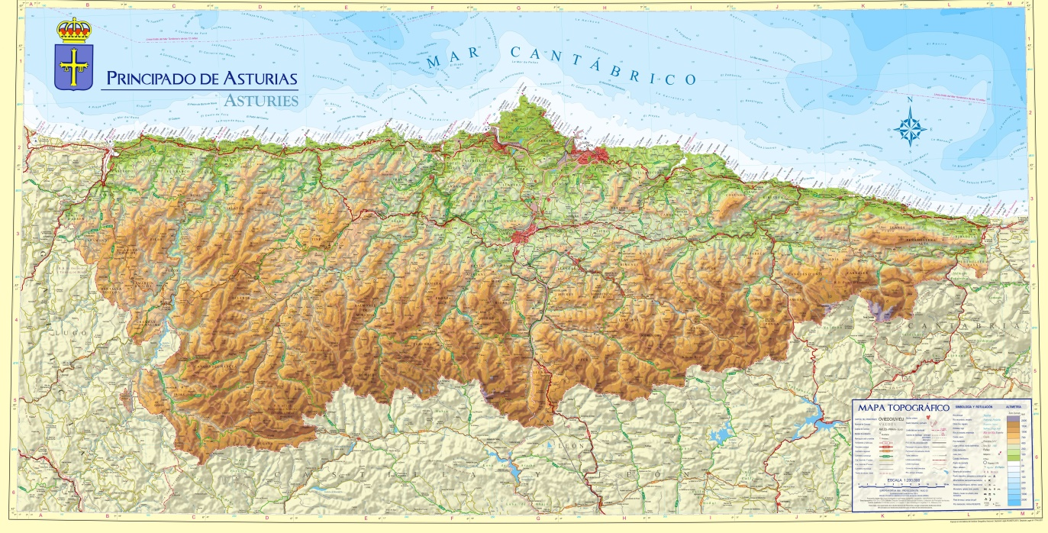
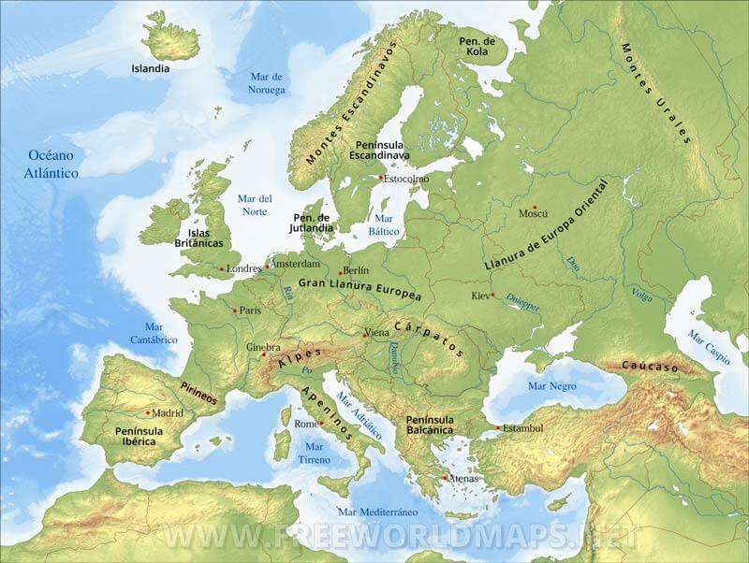
ASTURIAS IN EUROPE
FONFARAÓN MARTELOSCOPE

Slide 3
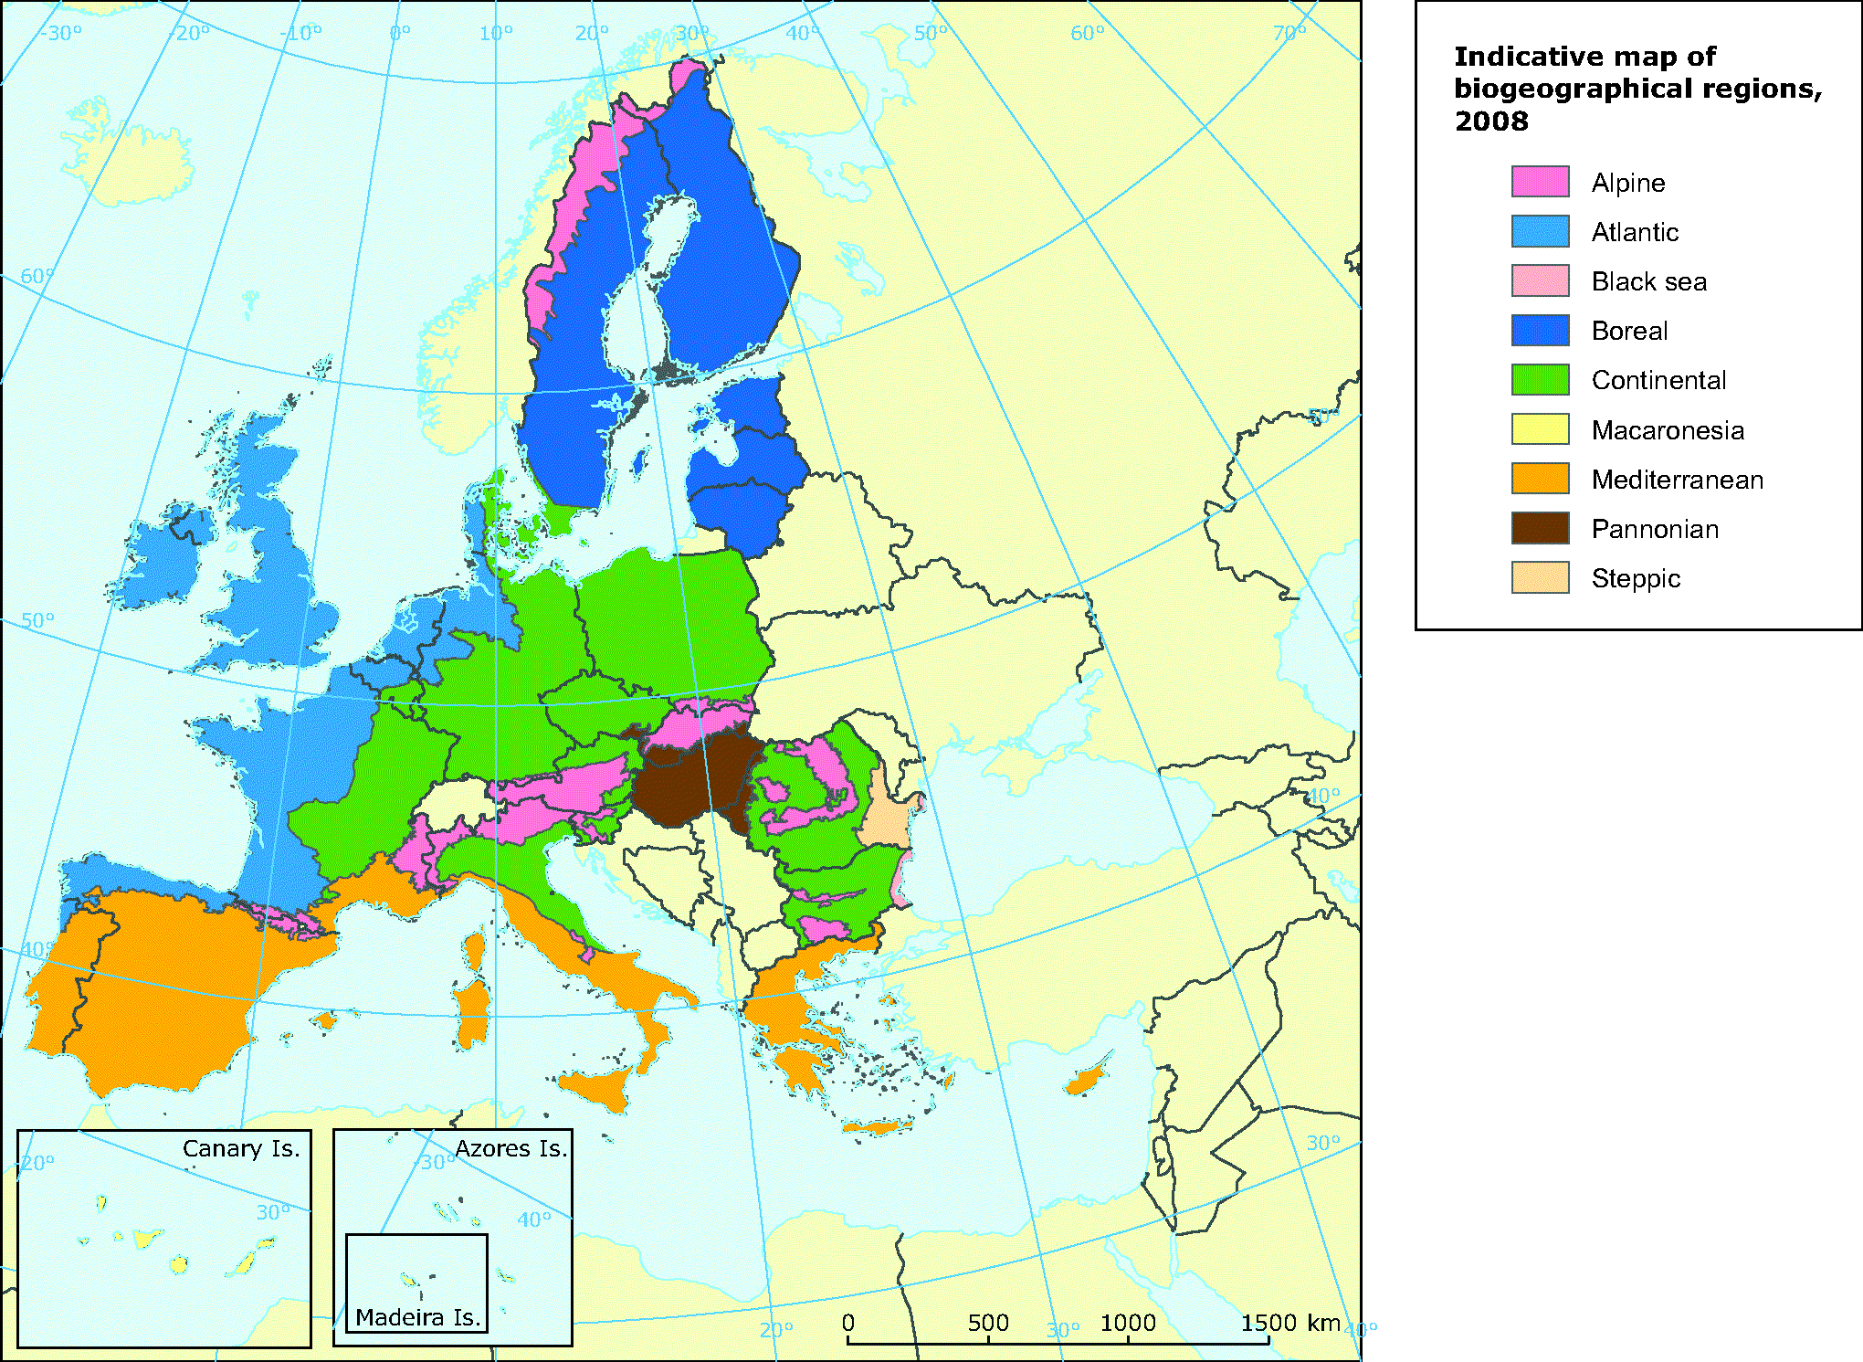
THE CLIMATE OF ASTURIAS
FONFARAÓN MARTELOSCOPE

Slide 4
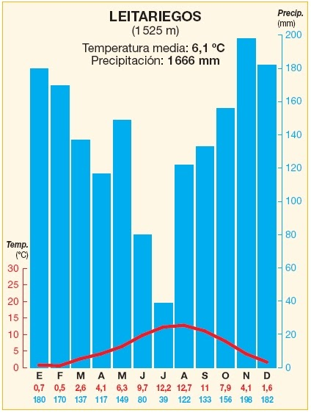
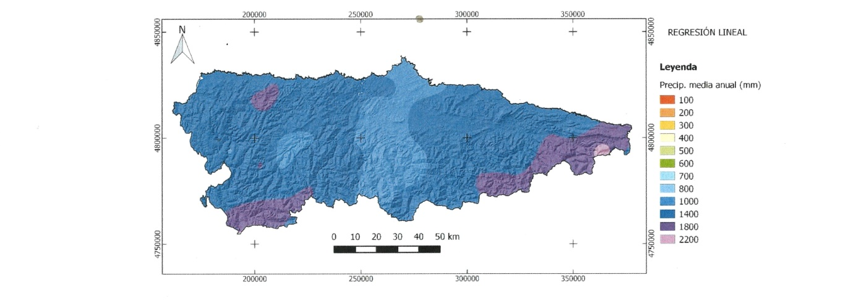
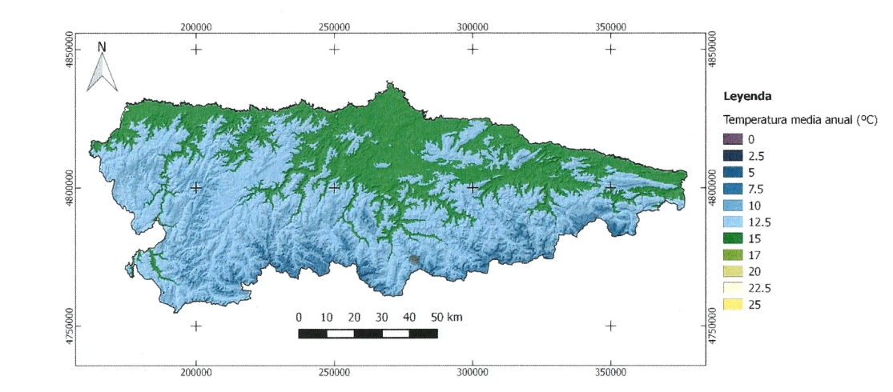
FONFARAÓN MARTELOSCOPE
RAINFALL AND TEMPERATURES IN ASTURIAS
MEAN ANNUAL RAINFALL
CARREÑO
860 mm
LEITARIEGOS 1666 mm
MEAN ANNUAL TEMPERATURE
CARREÑO
13,7ºC
- Mean Annual Temperature of Leitariegos (1525 m) (vegetation level montane): 6,2ºC
- Mean Annual Temperature of Carreño (vegetation level foothill): 13,7ºC
LEITARIEGOS 6,2ºC

Slide 5
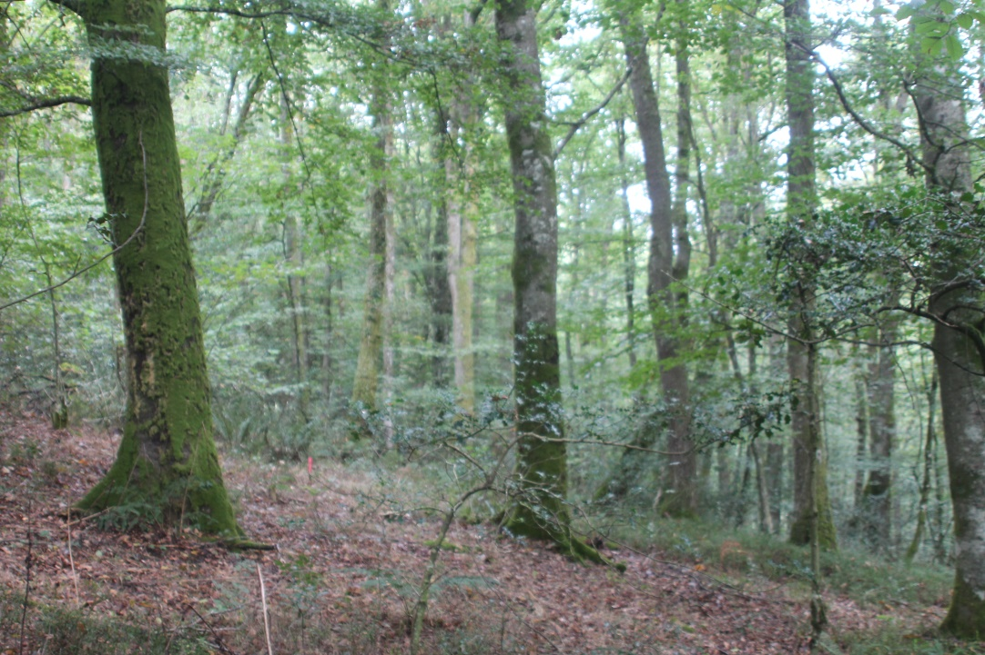
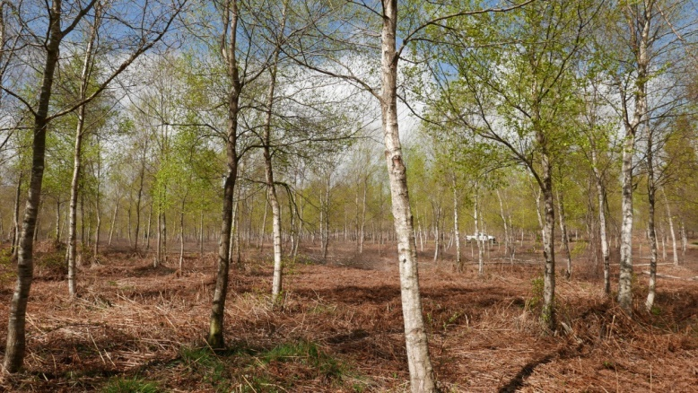
FONFARAÓN MARTELOSCOPE
DIFFERENT TYPES OF NATIVE WOODLAND IN ASTURIAS
(SIMPLIFIED)
Pedunculate oak forests (Quercus robur) (foothill forest)
Sessile oak forests (Quercus petraea) (montane forest)
Pyrinean oak forests (Quercus pyrenaica) (montane and foothill forest)
Beech forests(Fagus sylvatica) (montane forest)
Birch forests (Betula celtiberica,) (montane and foothill forest)
Chestnut forests (Castanea sativa) (montane and foothill forest)
Temperate broadleaf and mixed forest (Quercus robur, Castanea sativa, Betula celtiberica)
Oak forest with beech
Birch forest

Slide 6
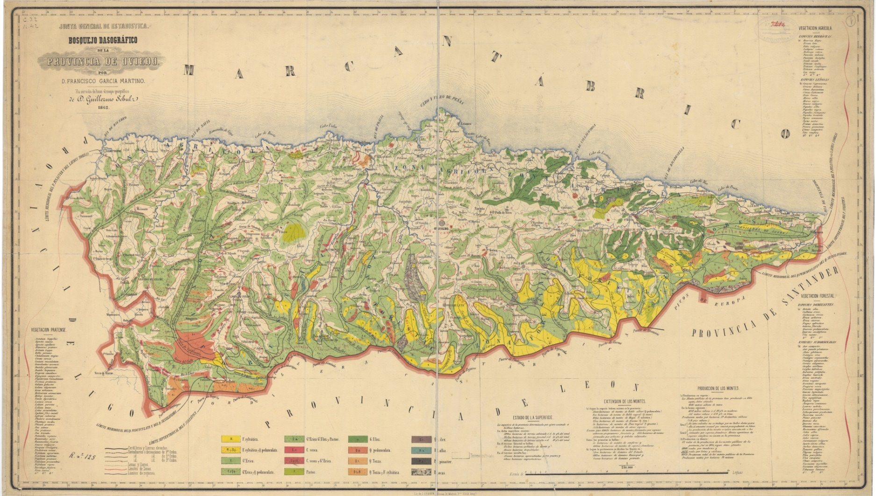
FONFARAÓN MARTELOSCOPE
THE EVOLUTION OF OUR FORESTS
SPECIES | AREA (1973) (ha) | AREA (2010) (ha)
Chestnut (C. sativa) | 48.000 | 80.000
Oaks (Q. robur, Q. petraea) | 18.000 | 39.000
Birch |  | 13.000
Temperate broadleaf and mixed forest |  | 95.000
Beech (F. sylvatica) | 39.000 | 68.000
Maritime pine (Pinus pinaster) | 45.000 | 22.500
Monterrey pine (P. radiata) | 26.000 | 25.000
Scots pine (P. sylvestris) | 18.000 | 8.000
Eucalyptus (E. globulus) | 25.500 | 60.000
Above: Forest Map of Asturias (1862)
Yellow: beech
Brown: oaks
Green: different shrubs (heather landscape)
White: agriculture surface
Source: National Forest Inventories

Slide 7
FONFARAÓN MARTELOSCOPE
OUR WOODLANDS TODAY
 | SPECIES | AREA (2010) (ha) | ANNUAL HARVEST (m³)
CULTIVATED FOREST | Maritime pine (P. pinaster) | 22.500 | 67.000
 | Monterrey pine (P. radiata) | 25.000 | 94.000
 | Scots pine | 8.000 | 24.000
 | Eucalyptus globulus | 60.000 | 800.000 | 93 % private property
NATIVE BROADLEAVED FOREST | Chestnut (C. sativa) | 80.000 | 25.000 | 80 % private property
 | Oaks (Q. robur, Q. petraea, Q. pyrenaica) | 39.000 | 6.000
 | Birch (B. celtiberica) | 13.500 | 3.800
 | Beech (F. sylvatica) | 68.000 | 1.700 | 84 % public property
 | Temperate broadleaf and mixed forest | 95.000 |  | Oaks, beech, chestnut, birch mixed
Source: 4th. National Forest Inventory and statistic of the Regional Forest Service
Source: 4th. National Forest Inventory and statistic of the Regional Forest Service

Slide 8
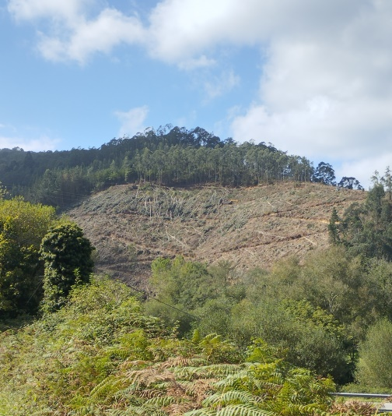
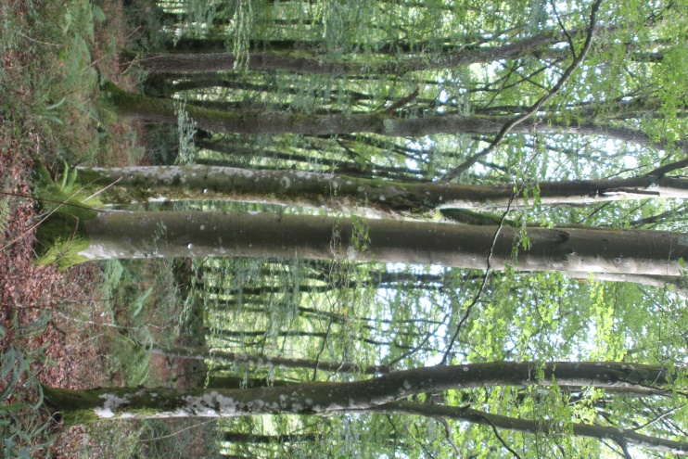
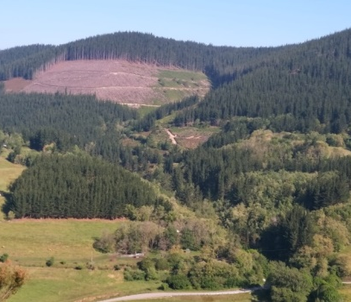
FONFARAÓN MARTELOSCOPE
OUR WOODLANDS TODAY
Monterrey pine forest
Eucalyptus plantation (clearcutting)
Beech forest

Slide 9
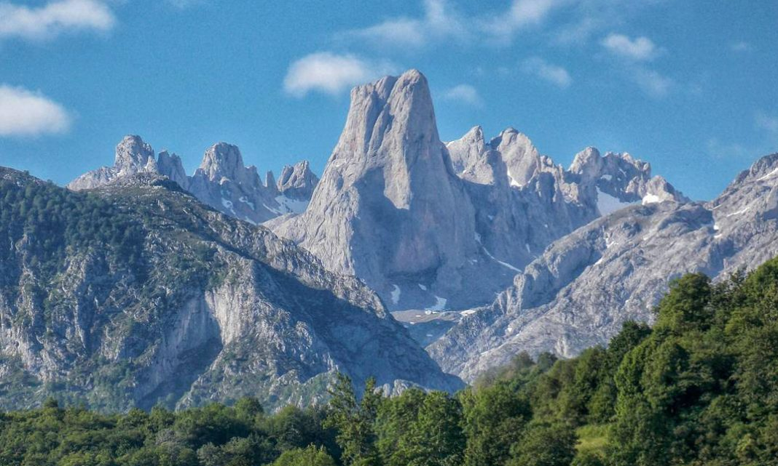
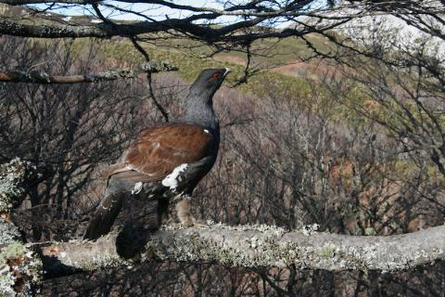
FONFARAÓN MARTELOSCOPE
NATURE CONSERVATION IN ASTURIAS
1918: First National Park of Spain was declared in Asturias “Montaña de Covandonga”, in 1995 and 2015 the Park has been amplified to 67.000 ha and now it´s called “Parque Nacional Picos de Europa”.
1982: The first Biological Reserve was created in the state forest of “Muniellos”, 2.622 ha of sessile oak forest with an important brown bear population. Present the total area of the reserve is of 5.970 ha.
1984/88: Nature Conservation was separated from the Forest Service.
1988: The first Nature Park in Asturias “Somiedo” was created in another important brown bear area.
2008: 281.000 ha (26%) of Asturias is protected, 37% of the protected area are woodlands.
National Park “Picos de Europa”
Capercaillie (Foto J. Benito)

Slide 10
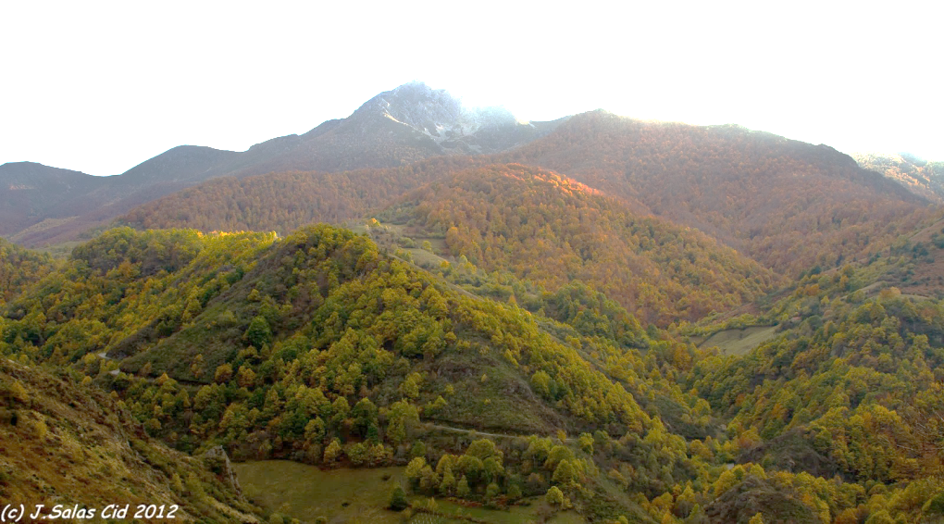
FONFARAÓN MARTELOSCOPE
NATURE CONSERVATION VS SILVICULTURE
In the past the management of the native woodlands was inspired presupposing that a classical silviculture meets nature conservation.
Conservacionist movement, began to see forest management as the principal threat for biodiversity in our mountains. The managers instead of looking for alternatives, reduced slowly the management.
The result is that forest management and silviculture in sensitive areas, special in public forests, have been lost.
This fact gets against a multifunctional and sustainable view of forest management?
The problem is the absence of a debate of this situation and there is no search for alternatives.
Marteloscope as an element of forest pedagogy, can be a meeting point to discuss about the management of our native woodlands and improve silviculture.
Image: Beech and oak forest in Nature Park “Ubiñas-La Mesa”, Public forest “El Grande” (M.U.P.)

Slide 11
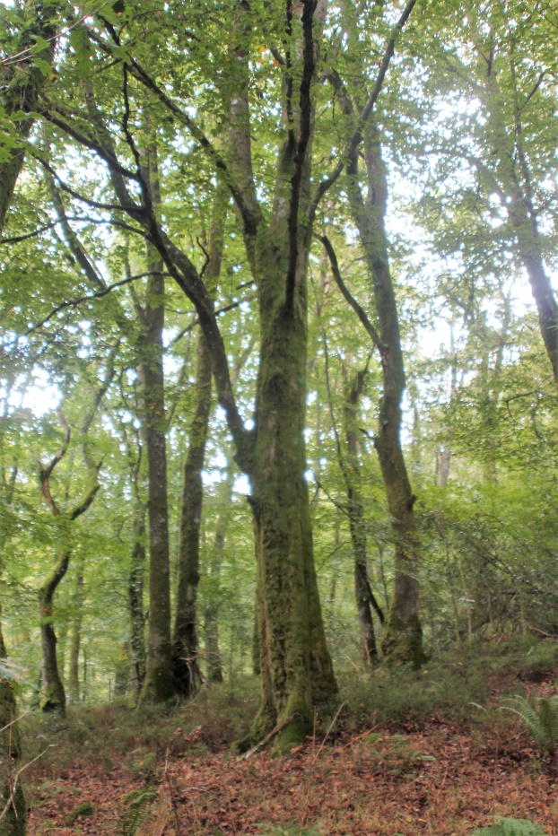
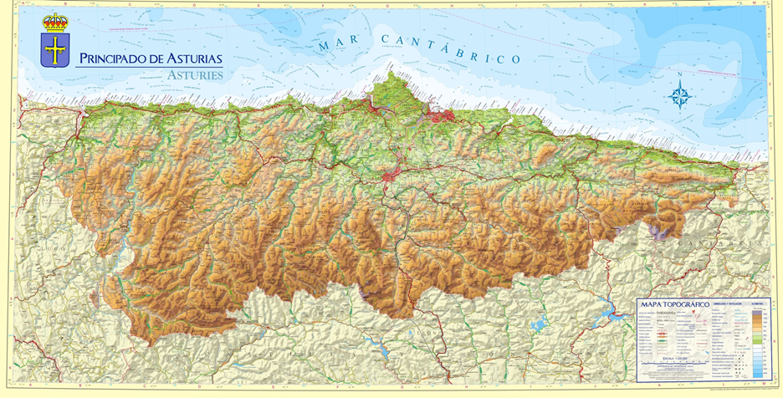
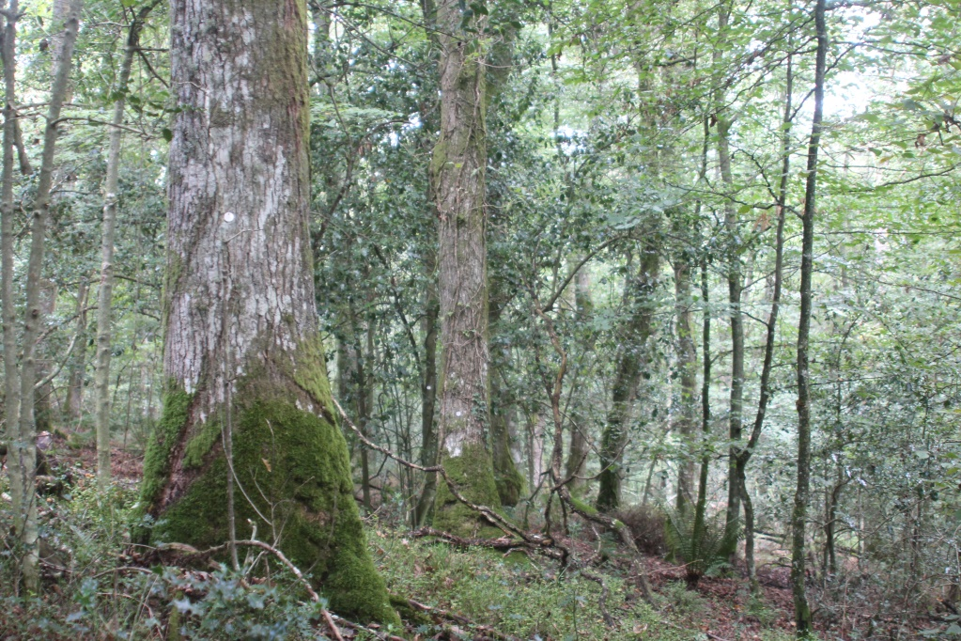
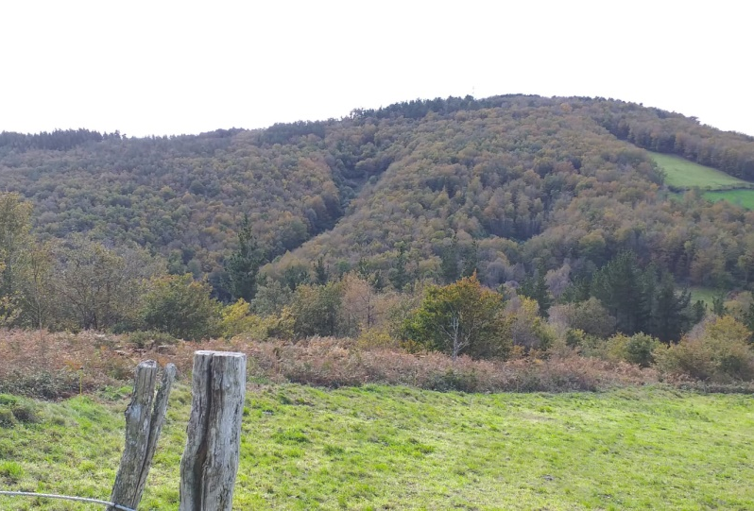
FONFARAÓN MARTELOSCOPE
FONFARAON MARTELOSCOPE

Slide 12
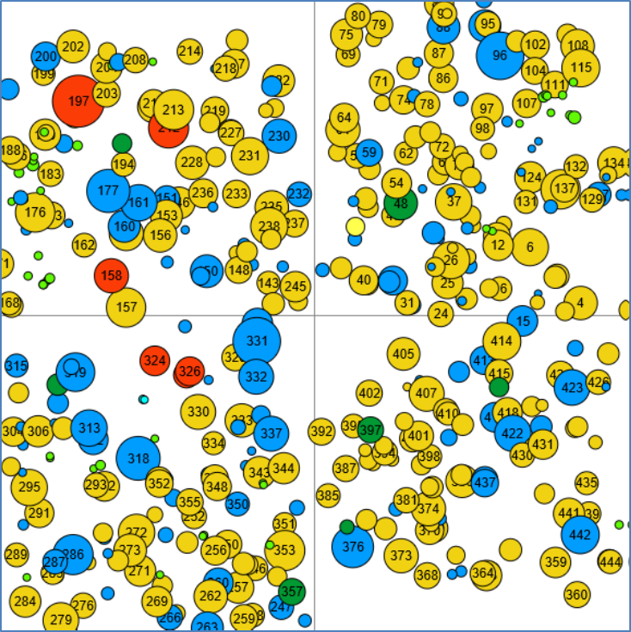
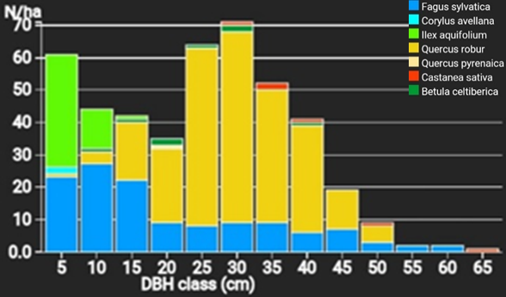
FONFARAÓN MARTELOSCOPE
FONFARAON MARTELOSCOPE
TECNICAL INFORMATION:
Fonfaraon Marteloscope is in the public forest of the Tineo council, “Sierra de Fonfaraón y Mulleiroso”
Altitude: 819 m.a.s.l.
Mean Annual Temperature: 10,6º C
Mean Annual Rainfall: 1200 mm
Natural forest community: Blechno spicanti -Querceto roboris sigmetum facies Fagus sylvatica. (Oligotrofic oak forest with beech)
Number of trees (N/ha): 443
Basal Area (m²/ha): 30,4
Volume (m³/ha): 207,1
Habitat value (points): 7.933
Image: DBH distribution of the marteloscope

Slide 13
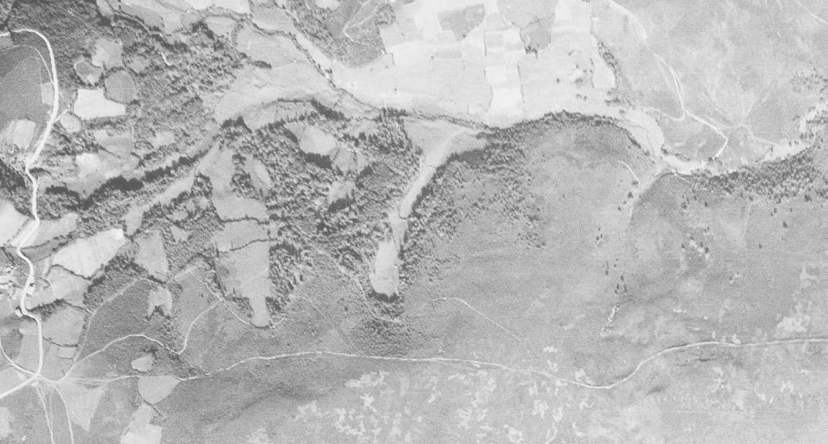
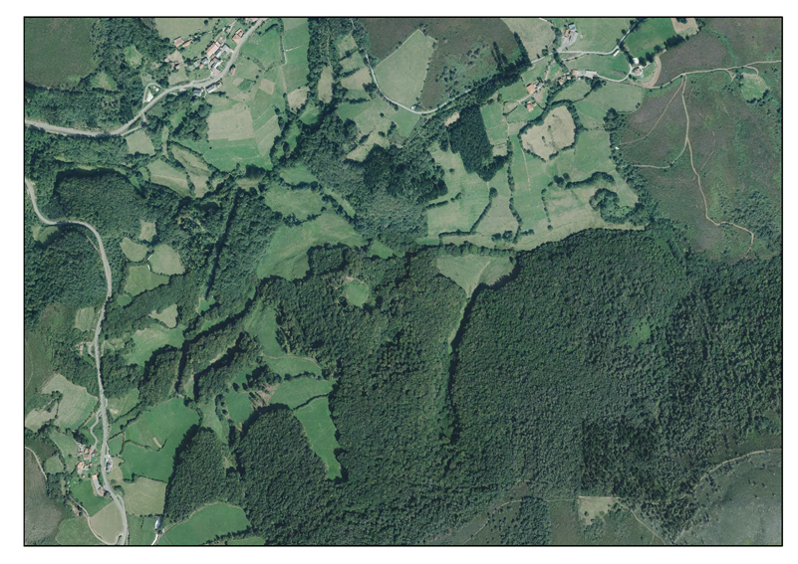
FONFARAÓN MARTELOSCOPE
FONFARAON MARTELOSCOPE
Image of 1946
MARTELOSCOPE
Image of 2020
INTEREST IN THE MARTELOSCOPE:
Faculty of Forest Science, University of Oviedo, to take the students of silviculture to make sign practica and discuss.
Foresters school of Tineo for practica.
Forest Service to make practica with forest rangers.

