Slide 1
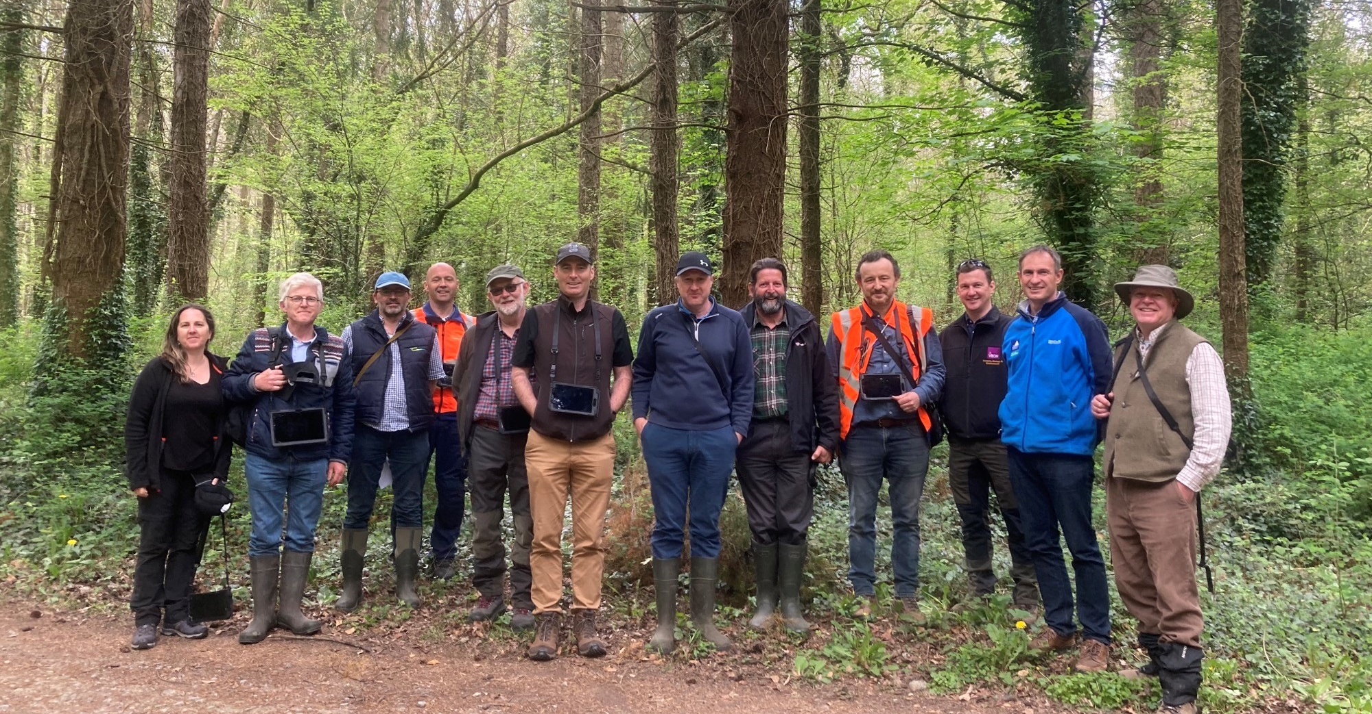

The Irish marteloscope training network Exploring integrated management potential with forest owners, foresters, forestry students and ecologists. Jonathan Spazzi, October 2022
Notes:
Thank you and good morning
I am delighted to have the opportunity to present to you the progress so far of our new training resource designed for forest owners, foresters, forestry students and ecologists.

Slide 2
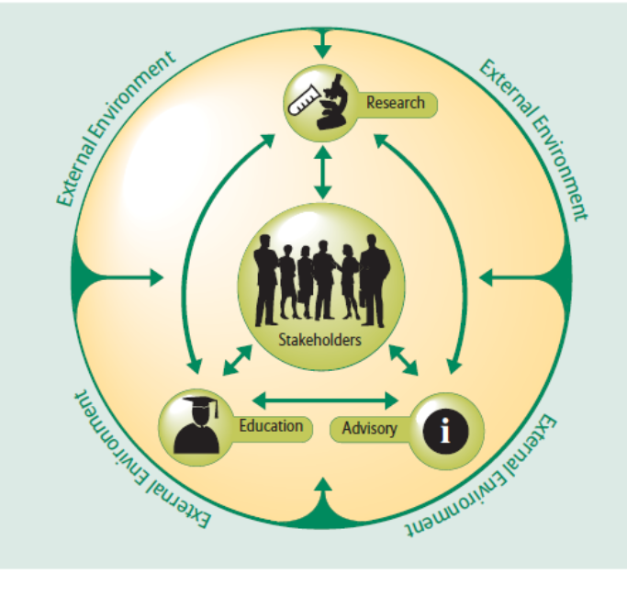
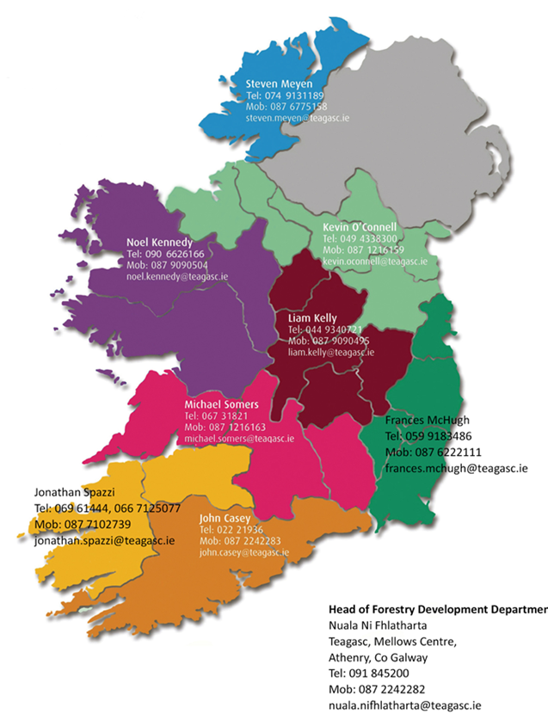

The Teagasc Forestry Development Department
Notes:
First a bit of context:
I work for Teagasc Forestry Development Department which is a state funded forestry extension agency integrating forestry advisory –research and education services
Our main stake holder being forest owners
I myself work as development office and work very closely with our research department and participate to a number of European research projects
I provide support to the south west region and have a national in relation to close-to-nature management development, education and training.

Slide 3
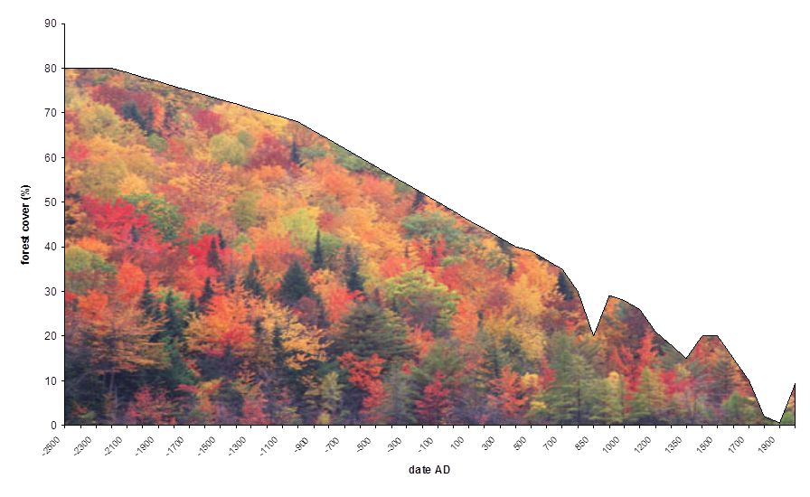

Irish forests history: from deforestation to reforestation
808,848 ha or
11.6% of the total land area of Ireland
Notes:
To understand Irish forestry is important to take an historical prospective
Ireland over the last few centuries experience near total deforestation with little more that 1% of land surface in forest at the beginning of the 1900
However since than I we have seen a fast reforestation trends primarily driven by state funded afforestation programmes
To date we have 11%

Slide 4
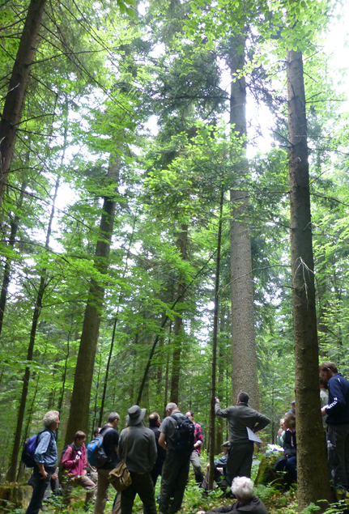
Irish forestry current evolution
Growing interest amongst forest owners and foresters on integrated management options
Hands-on owners with high level of engagement
Production, personal satisfaction, biodiversity and legacy mix
Opportunity to diversify silviculture but also to foster a new forest-use culture
Successful roll out of the DAFM CCF and NW schemes
Project Woodland
“We need to develop a ‘Close to Nature’ model of forestry which also recognises the significant downstream benefits of forestry for the rural economy and the increasing role which timber can play as a climate friendly construction material”. Press Release, Minister Pippa Hackett
Recognised training-need for owners, foresters and contractors
Notes:
In recent years we have seen rapid evolution of Irish foresty
Looking at the private forestry scene in recent years in Ireland we have seen a growing interest in CCF sytemes comomig from some forest owners
Which in many cases , and certainly this is my experience, share similar motivations and drive :
Hands-on owners
High level of engagement
Most share a production, personal satisfaction, biodiversity and legacy mix
Opportunity to diversify silviculture but also to continue foster a new culture of active management and multipurpose forest-use
All of which has underpinned the successful rolled out of the new CCF Scheme and NW
Here is a recent statement by our minister with responsibility for forestry as part of a National Consultation process called project woodland
However with all that said it is important to highlight the fact that that we do have a recognised training need for forest
owners but also foresters and contractors and in order progress further we will need to address this point next
Moving from the why to the how

Slide 5
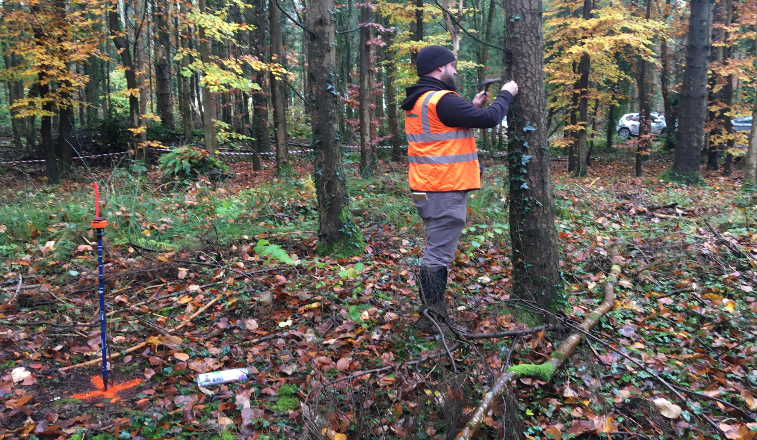

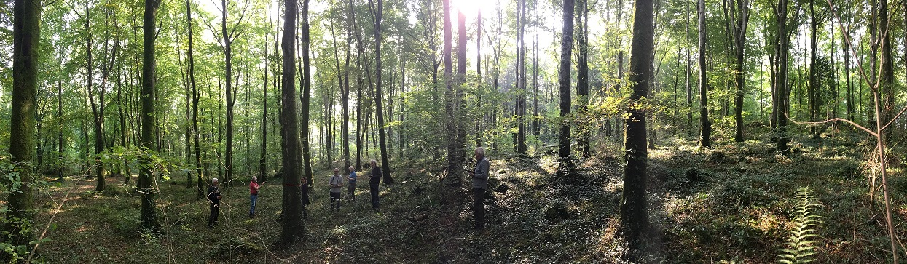
First phase of new training network 2019-2021
Meeting with Andreas Shuck in Ireland in 2018
Securing Teagasc internal funding in 2019
Installation of 3 new marteloscope plots/ purchase of tablets in 2019-2020
Development and testing of new blended training material
Despite Covid restrictions, 4 workshops for forest owners in 2020-2021
Notes:
Enter the the Integrate Network
First encounter was meeting Andreas Shuck in Ireland as part of CTN seminar Tegasc organised and at the time is was like a switch went off and I would not rest until I was able to secure funding later in 2019
-to install 3 new marteloscope plots/purchase tablets

Slide 6
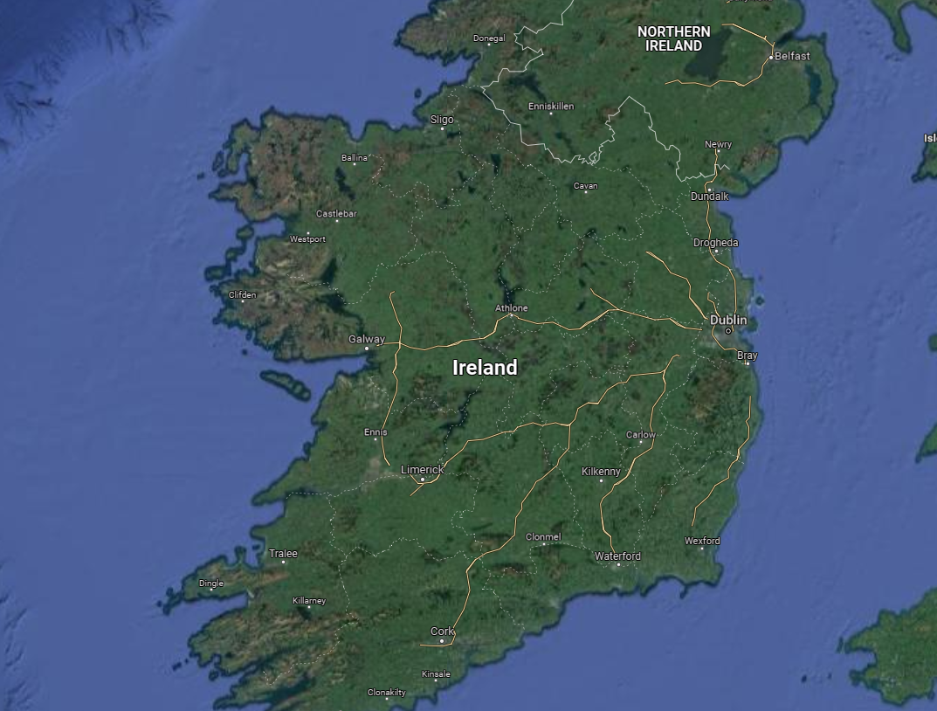


The Irish marteloscope network
2x Oak Park
Curragh Chase
Notes:
Here are the current marteloscope plots develop by Teagasc
One South of Limerick City in Curragh Chase forest in partnership with Collte
Two in Oak Part Teagasc research center
It is possible that given demand we might develop futher plots in other locations
5 more installed by Colliite the State Forestry board managing state owned forests as part of their Bio Forest programme

Slide 7
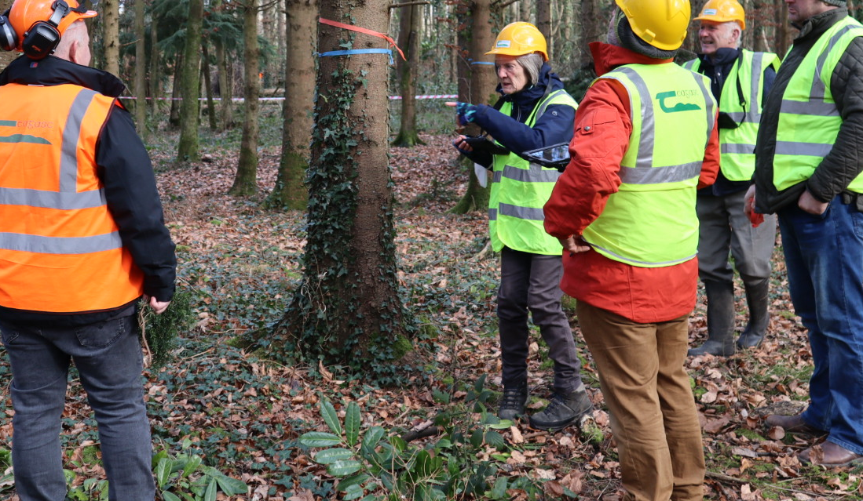
Teagasc marteloscope workshops 2022
11 marteloscope workshops so far this year-over 100 participants
Each workshop 10/12 participants
Content and the level of interaction tailored to each user group
All day workshops: 3 for forest owners/ 1 for forestry students/ 3 for foresters plus 3 short intro workshop for a range of other organisations
1 joint workshop with Coillte Bioforest marteloscope network

Slide 8
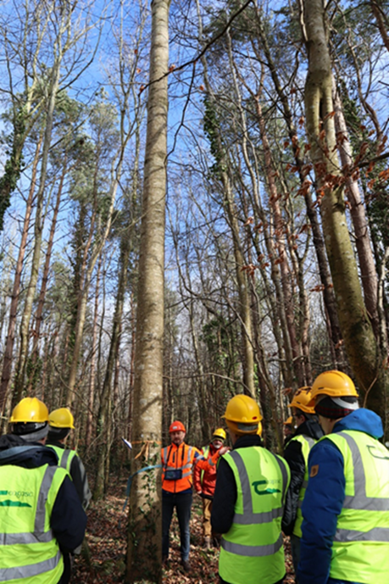
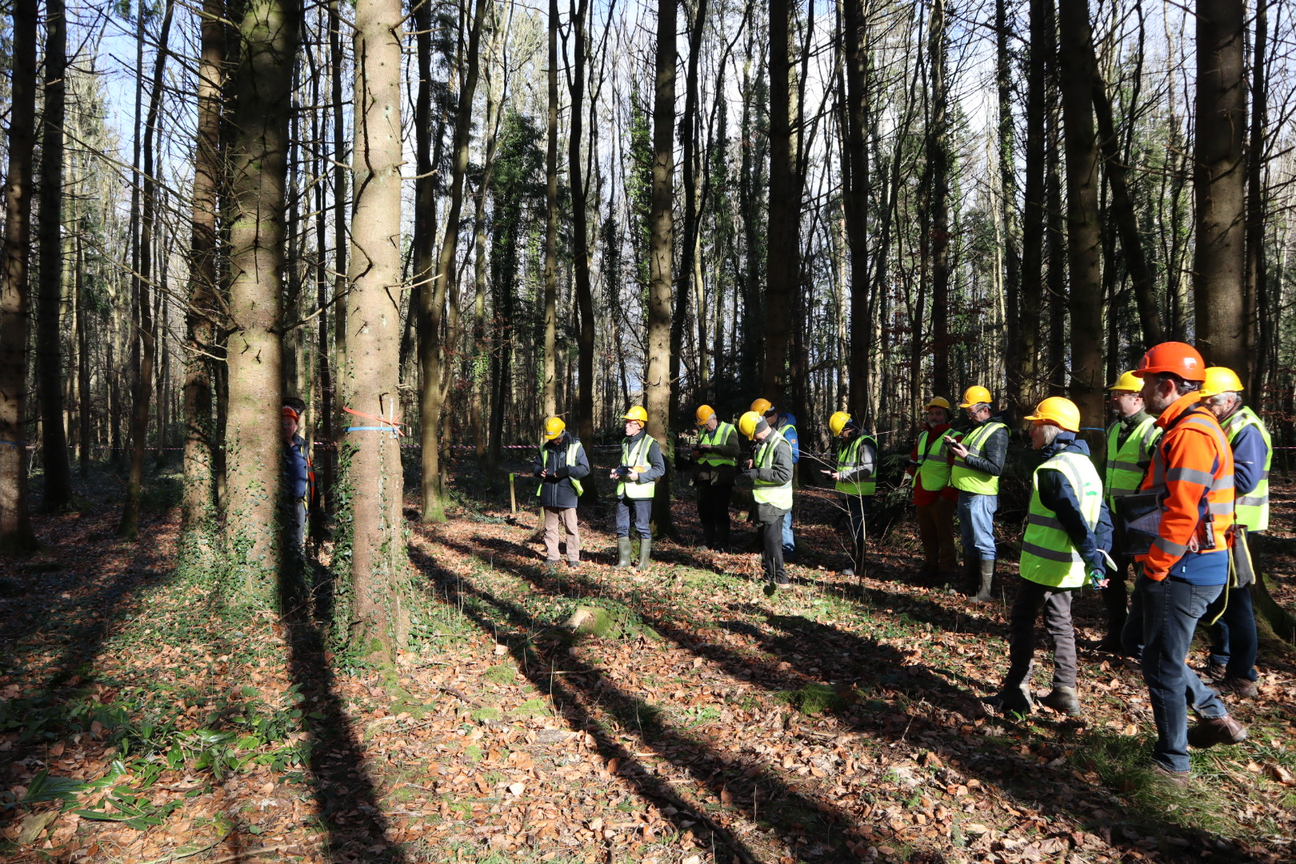
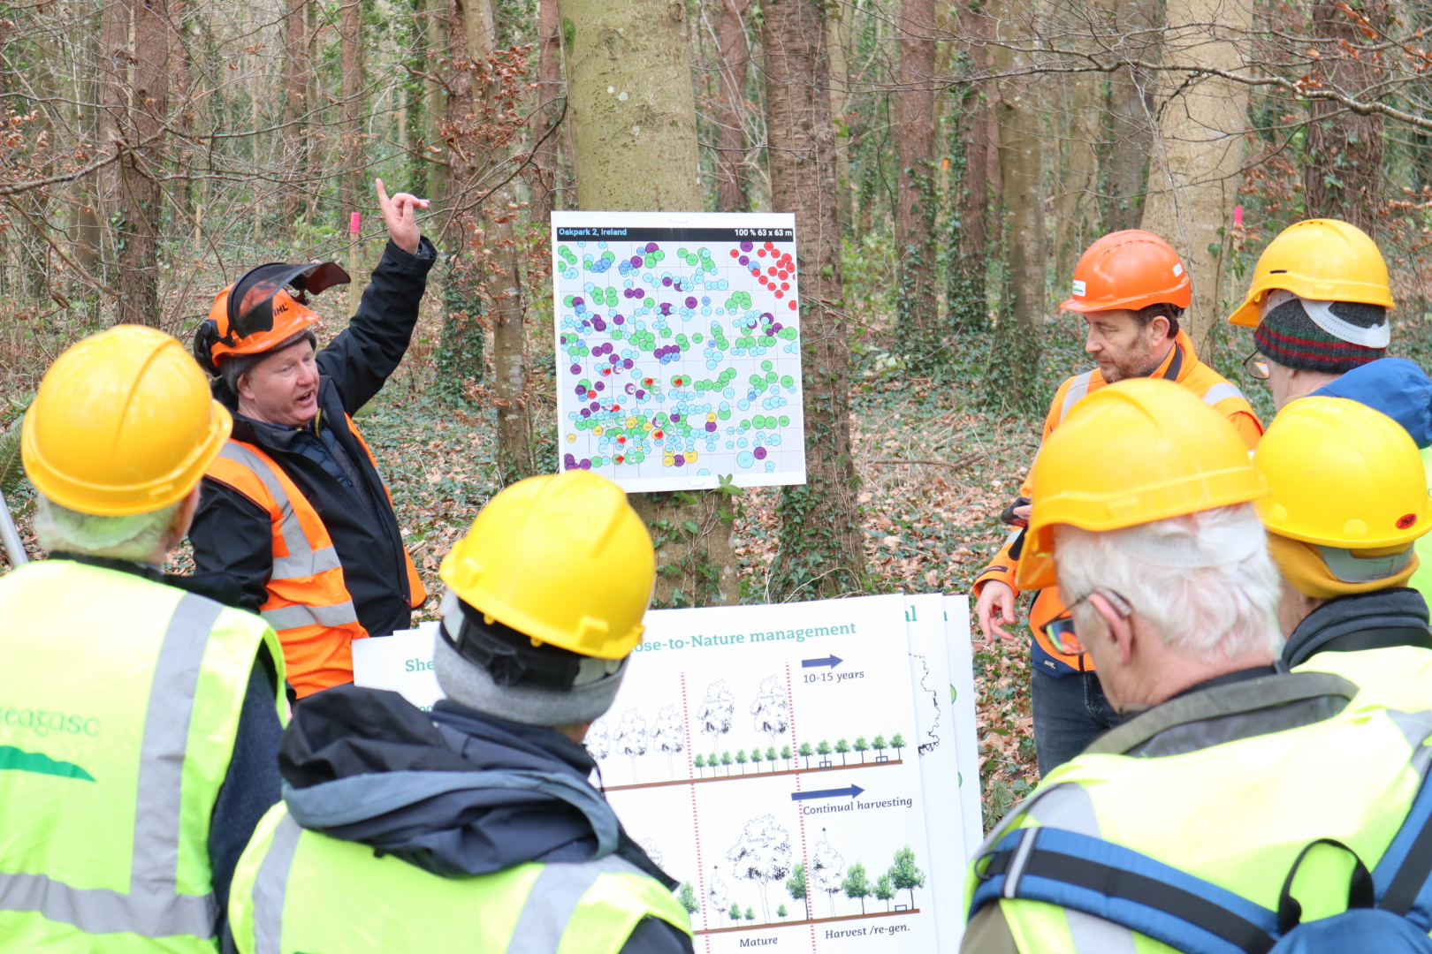
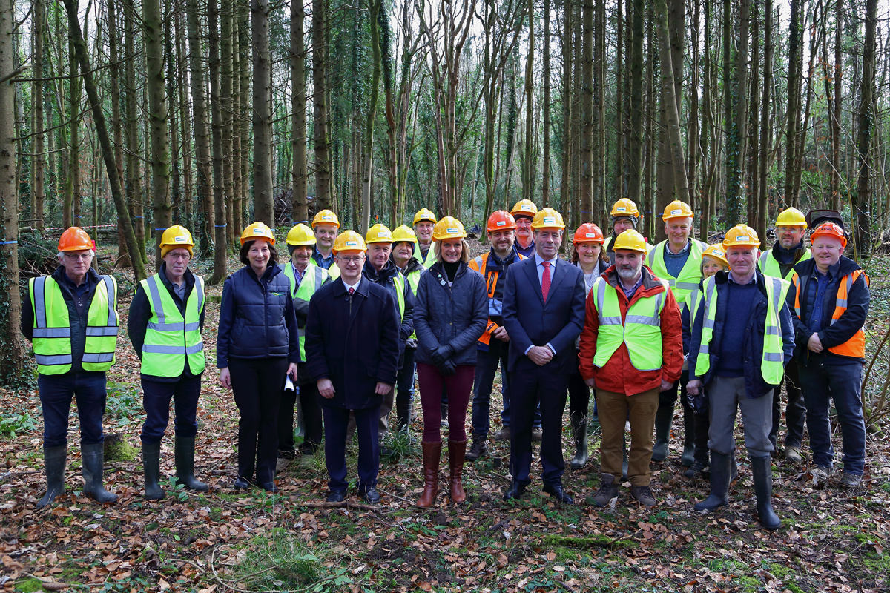
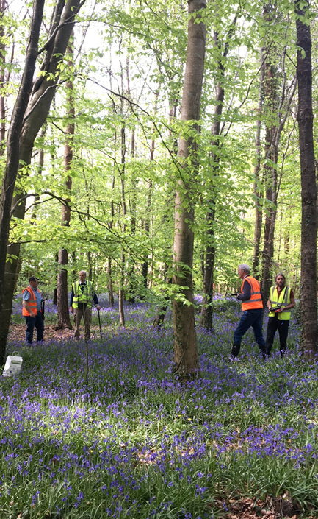
Forest owners workshops
Launched by the Minister of State Senator Pippa Hackett in Oak Park in February
To Inform on different forest management scenarios
To practice the key skill of selecting trees by their quality-vigour and biodiversity value
To demonstrate in practice integrated management potential
Notes:
Learning from doing- hands on and discussion based training.
Trying to keep it enjoyable and engaging while also delivering some technical content.

Slide 9
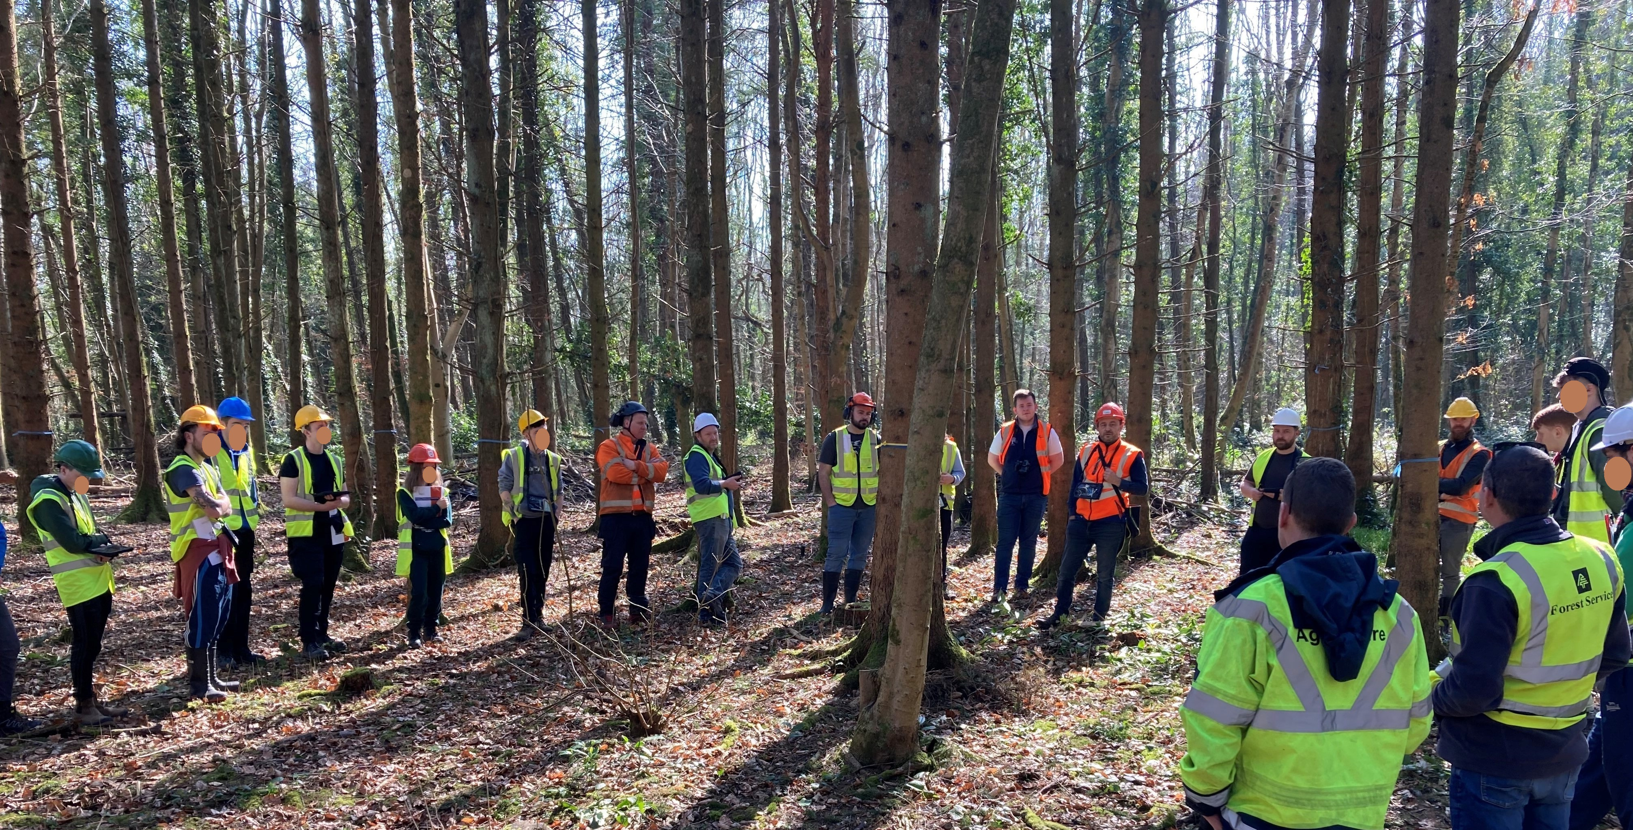
Forestry students workshops
Similar structure to forest owner workshop but more in depth
Discussion on silvicultural systems, tree-focused silviculture and Close to Nature management
Notes:
The general approach remain the same but getting a bit more technical
My experience is that thnis user group was the most dynamic and where the level of engagement and learning is possibly the greatest

Slide 10

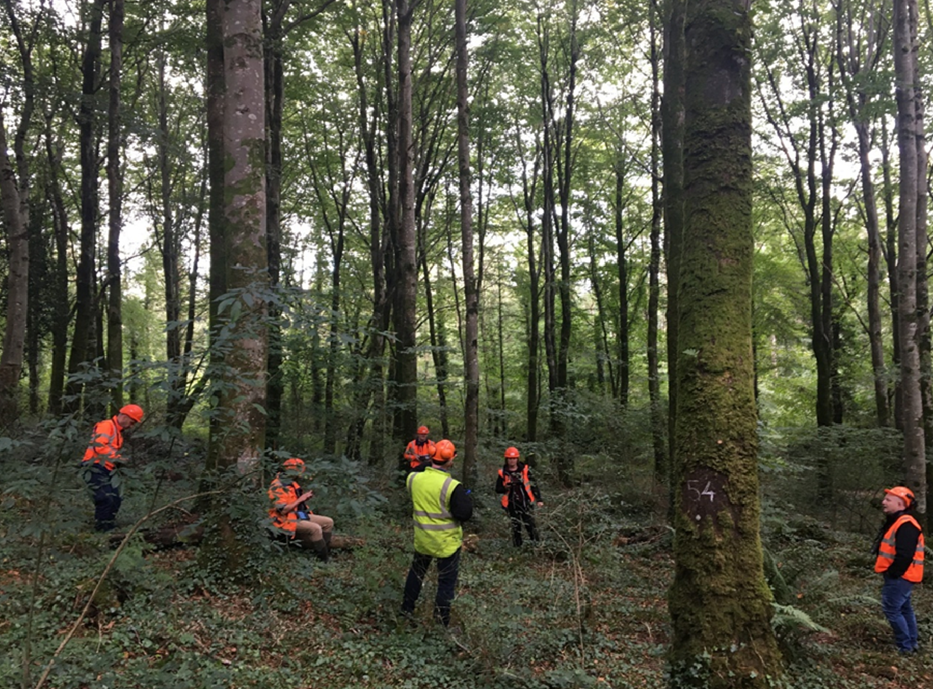
Foresters workshops
Integrating hardwood production with ecosystem services, forest resilience
Exercises in young plantation and in a more advanced marteloscope plot
Explores tree-focused silviculture and close to nature management
Teagasc also collaborating with DAFM/PSI to foresters workshops for the CCF scheme
Notes:
Some how different- Complexities of the market and grant aiding tools

Slide 11
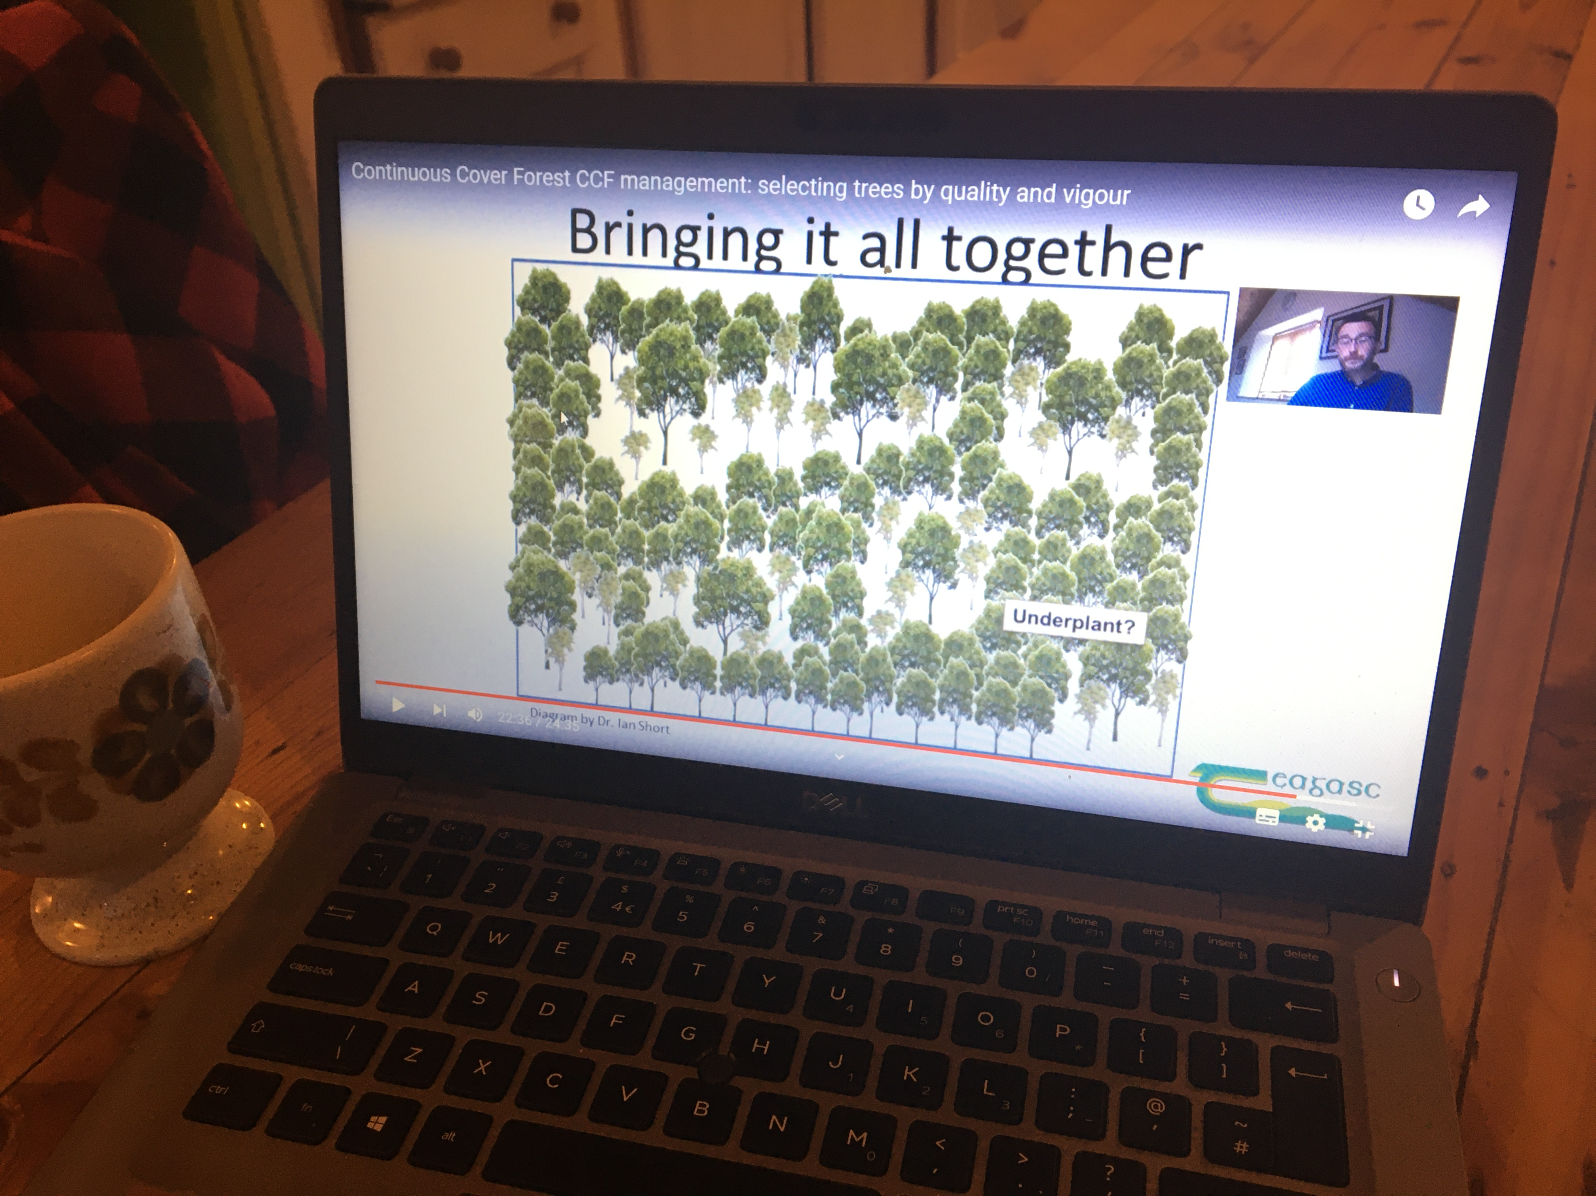
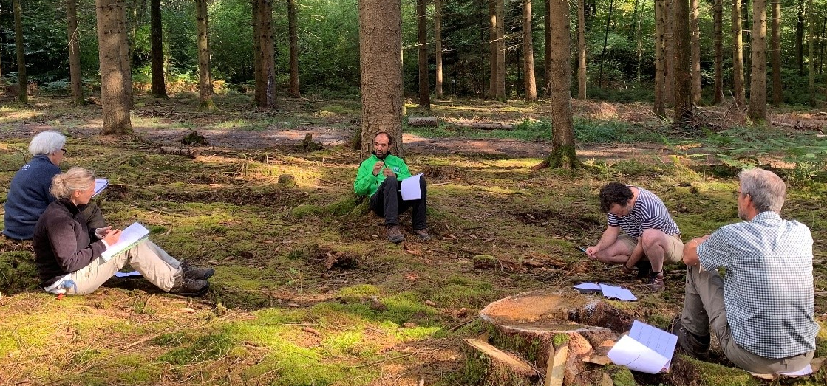
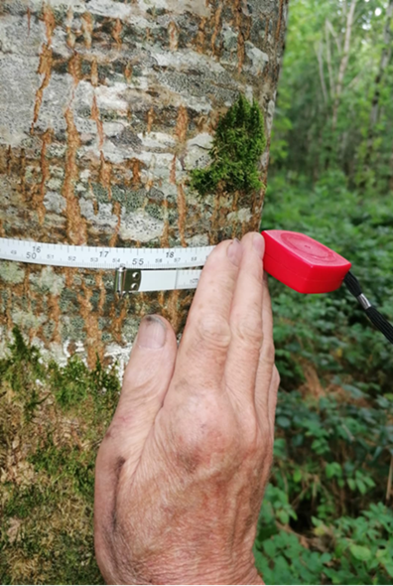
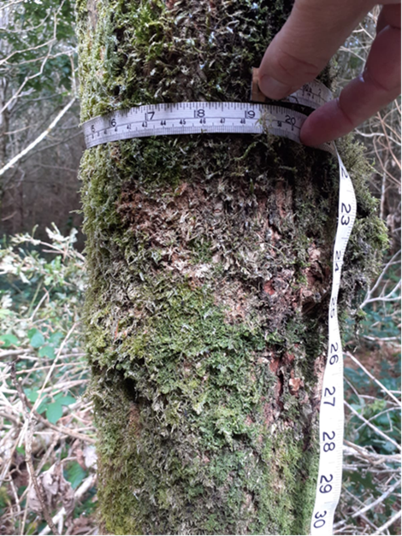
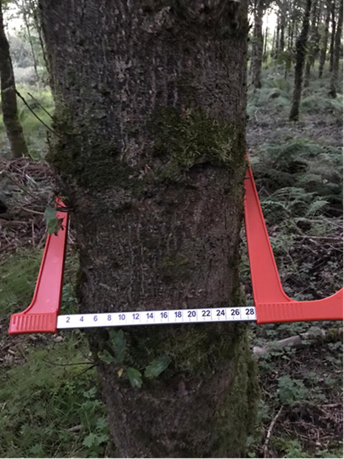
“Virtual classroom” training
Four weeks online programme: facilitation-style virtual meetings, video tutorials and interactive exercises
Owners are to explore their woodland, carry out practical exercises and share results with their peer group through a forum
The video tutorials allows participants to join in remotely in the comfort of their home and explore the subject matter
Marteloscope workshop as end of the course validation
Led to new Erasmus+ (MOOC-For-Change) : design and deliver state of the art interactive online course on CtN management to reach 10000 participants in 3 languages in the next 3 years.
Notes:
One associated development is a “virtual classroom” educational resource that was initially developed in response to Covid
The video tutorials allows participants to join in remotely in the comfort of their home and get stuck into the subject matter
See the pictures shared by participants as party of a tree selection and measurement exercise
The project team initial brainstorming session in the forest this summer as part of first project meeting in Belgium
The MOOC programme will be used as part of our marteloscope workshops in Ireland

Slide 12
Future plans
Process feedback from participants so far to update and improve workshops
Continue to offer workshops for a range forest users
Increase collaborations with Coillte Bioforest ecologists and foresters
Continue to collaborate with DAFM and PSI to further support and develop the CCF transformation scheme
Further interaction with the Integrate Network partners and other European projects
Notes:
In conclusion we certainly had a busy year this year.
We aim to consolidate this experience by processing feedback

Slide 13
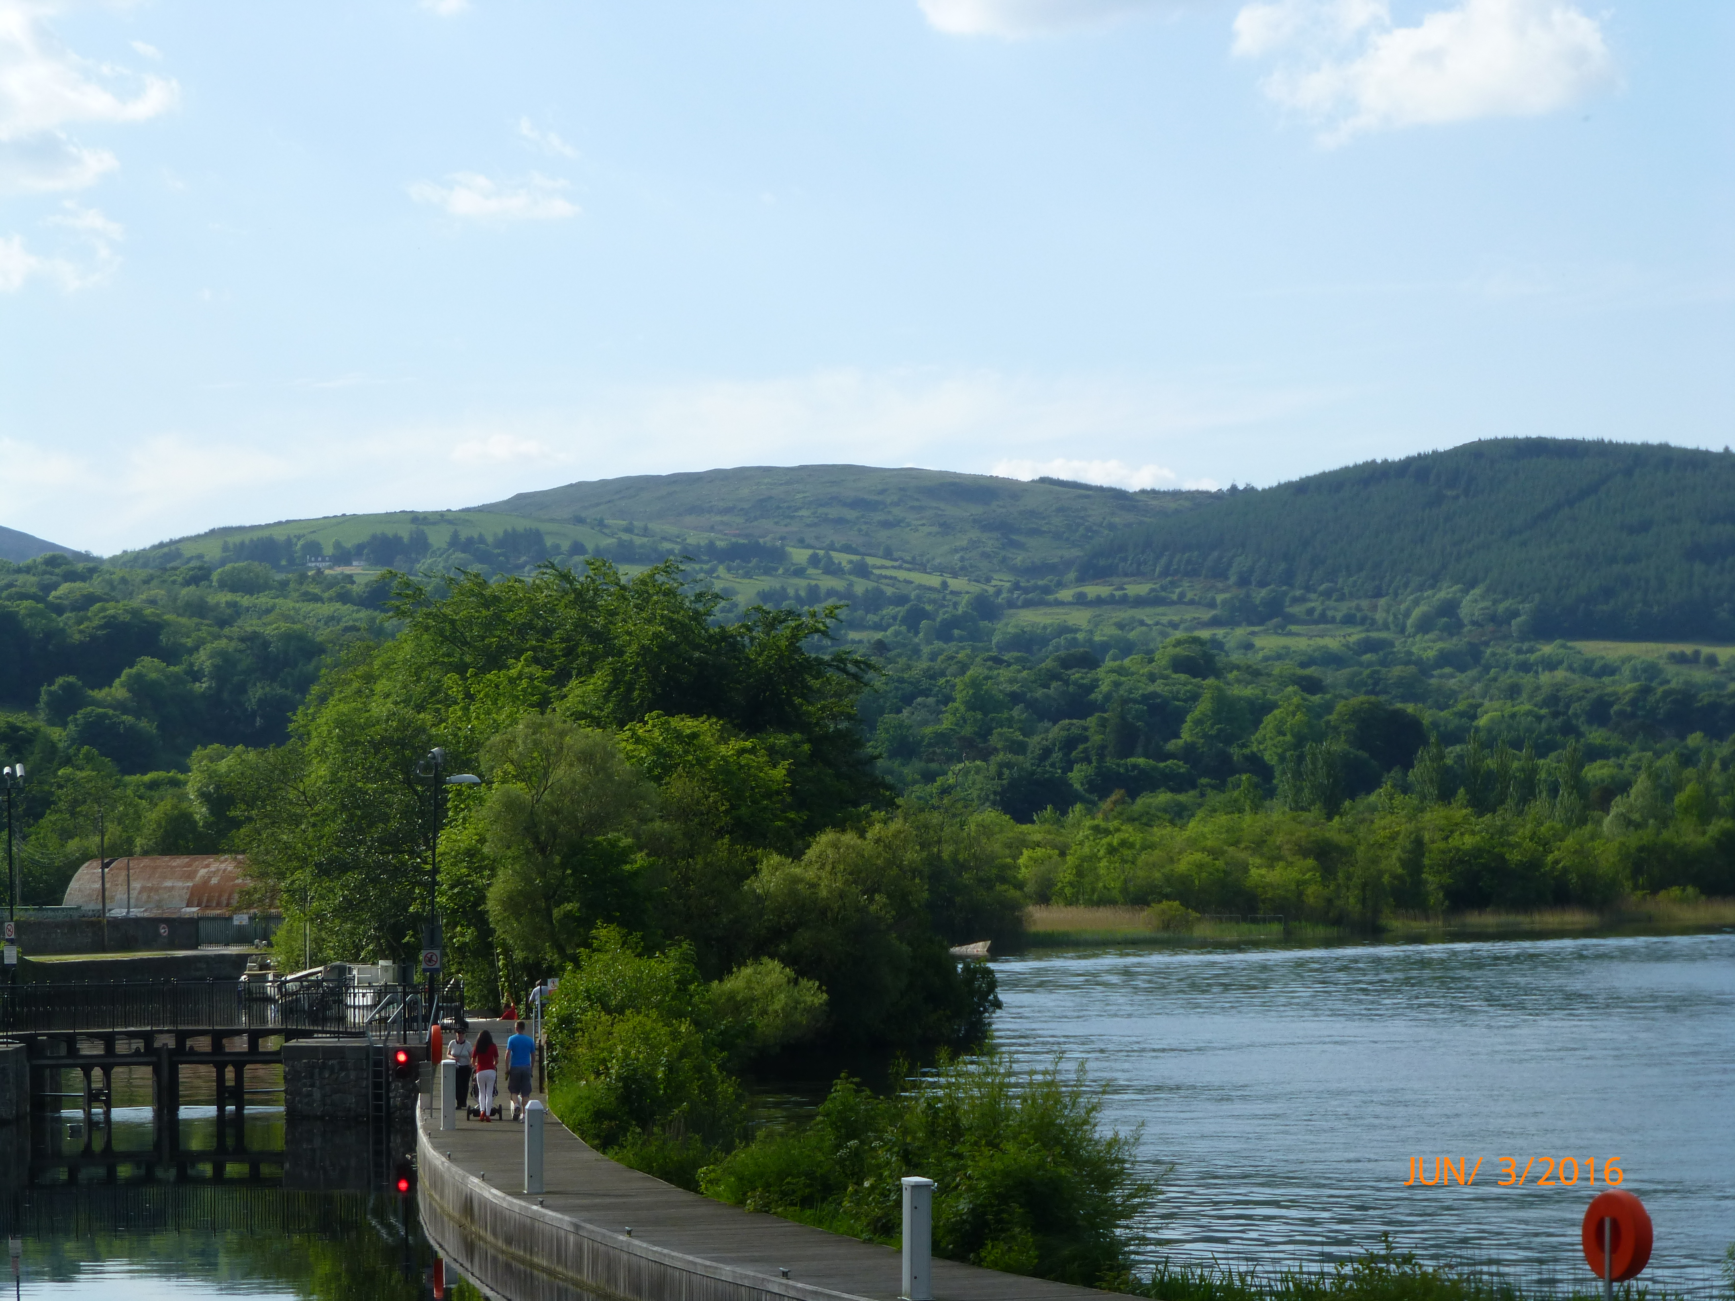


Thank you for your attention
Notes:
With this I thank you for your attention and in particular I look forward to your questions

